Slide 1



Data Analysis in R for Microbial Pathogen Surveillance Using TaqMan Array Cards (TAC)
June 25-27, 2025
Heather Amato, Assistant Professor, UMD
Chris LeBoa, Postdoctoral Researcher, UC Berkeley
Shiva Ram Naga & Aastha Shrestha, Center for Infectious Disease Research and Surveillance
Center for Infectious Disease Research and Surveillance
Research and Development Division
Dhulikhel Hospital Kathmandu University Hospital
Department of Global, Environmental, and Occupational Health
School of Public Health
University of Maryland College Park

Slide 2
Workshop Agenda - Day 1
Introductions (name, where you’re coming from, favorite food) 9:30 – 9:40
AMR & Zoonotic Pathogen Transmission in Nepal 9:40 – 10:00
Intro to TaqMan Array Cards (TAC) 10:00 – 10:10
Best Practices in Data Management & Processing 10:10 – 10:20
Set Up - Getting started in GitHub 10:20 – 10:50
Break 10:50 – 11:00
Script 1 Intro – Load packages and data 11:00 - 11:15
Script 1 – Run data processing steps 11:15 – 12:15
Recap & questions 12:15 – 12:30
Lunch 12:30 – 1:00

Slide 3
AMR & Zoonotic Pathogen Transmission in Nepal

Slide 4
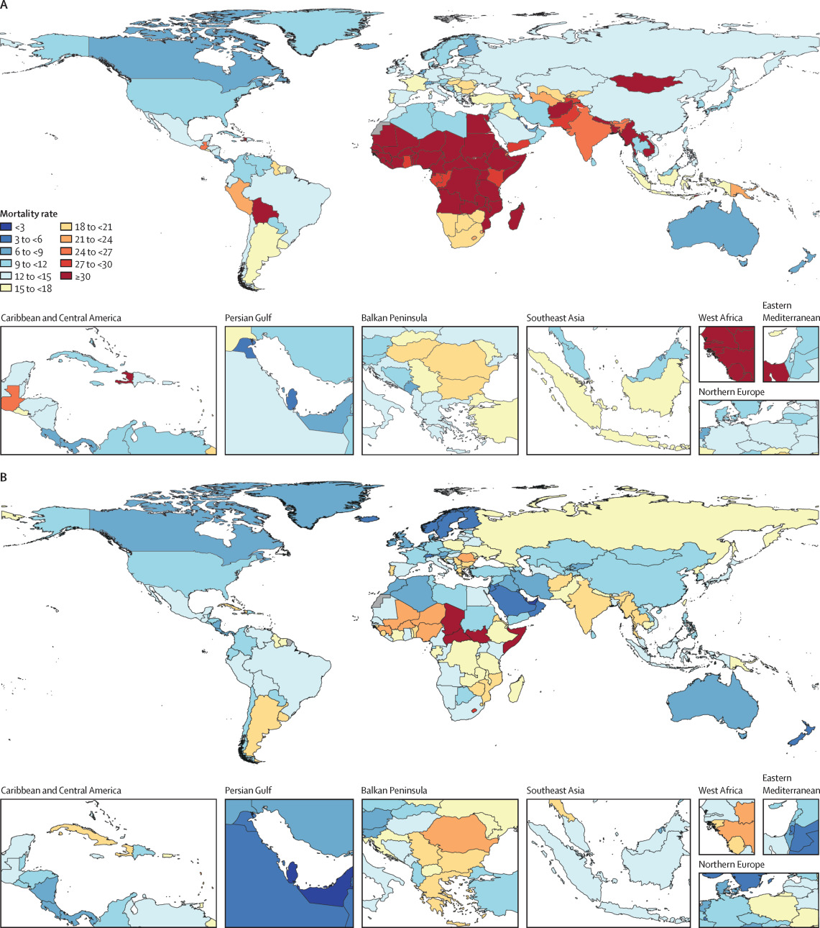
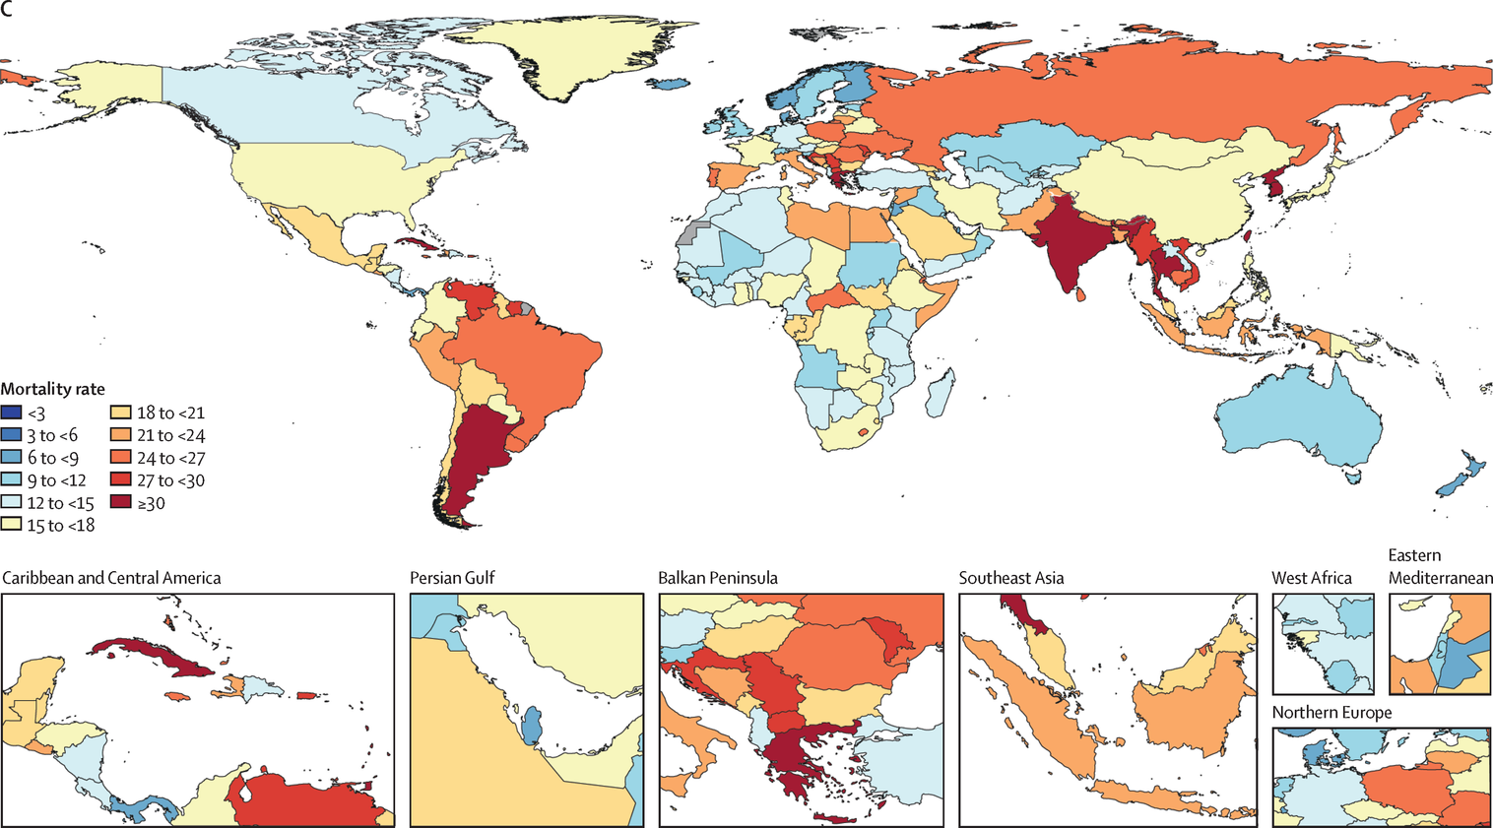
Burden of disease attributable to AMR
From 2022-2050, deaths due to AMR estimated to increase by 69.6%
Projected ~1.91 million deaths attributable to AMR in 2050
2021
2050
GBD 2021 Antimicrobial Resistance Collaborators, 2024,The Lancet

Slide 5
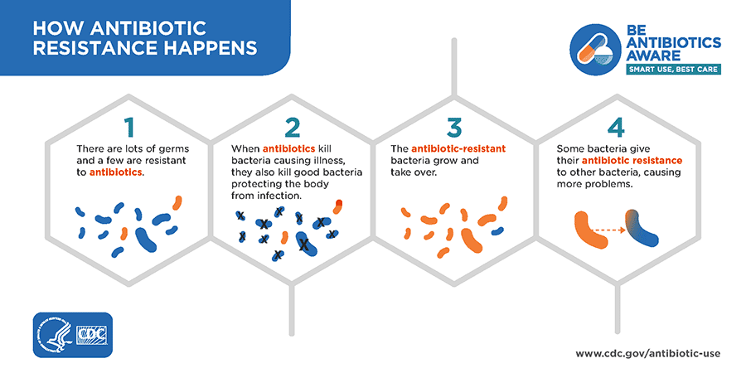
Burden of disease attributable to AMR
Primary pathogens driving AMR mortality include extended-spectrum beta-lactamase (ESBL) producing enteric (gut) bacteria:
E. coli
A. baumannii
K. pneumoniae
P. aeruginosa
2021
CDC
2050
GBD 2021 Antimicrobial Resistance Collaborators, 2024,The Lancet

Slide 6
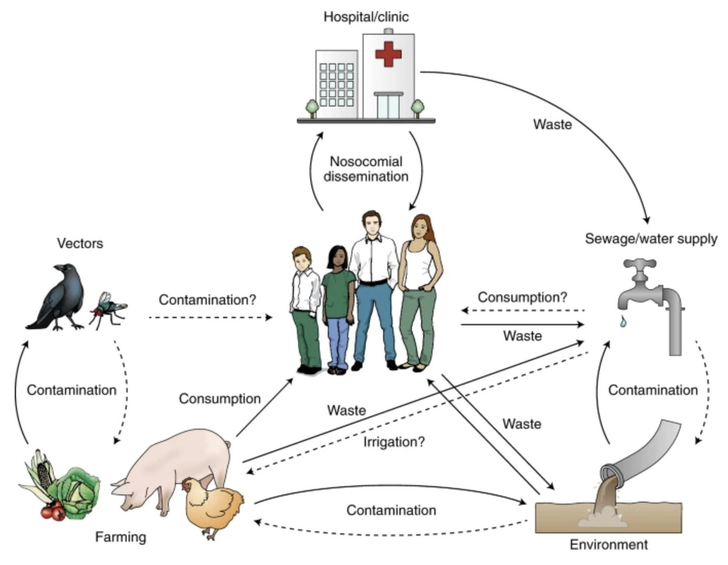
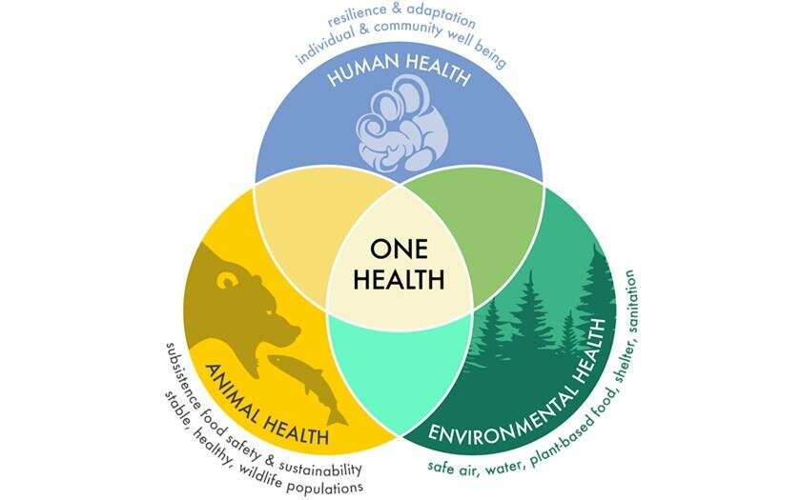
Drivers of AMR and pathogen transmission
One Health (interconnectedness of animals, humans, and the environment)
Katarzyna Nowak
Walsch et al. 2018, Nature Microbiology

Slide 7
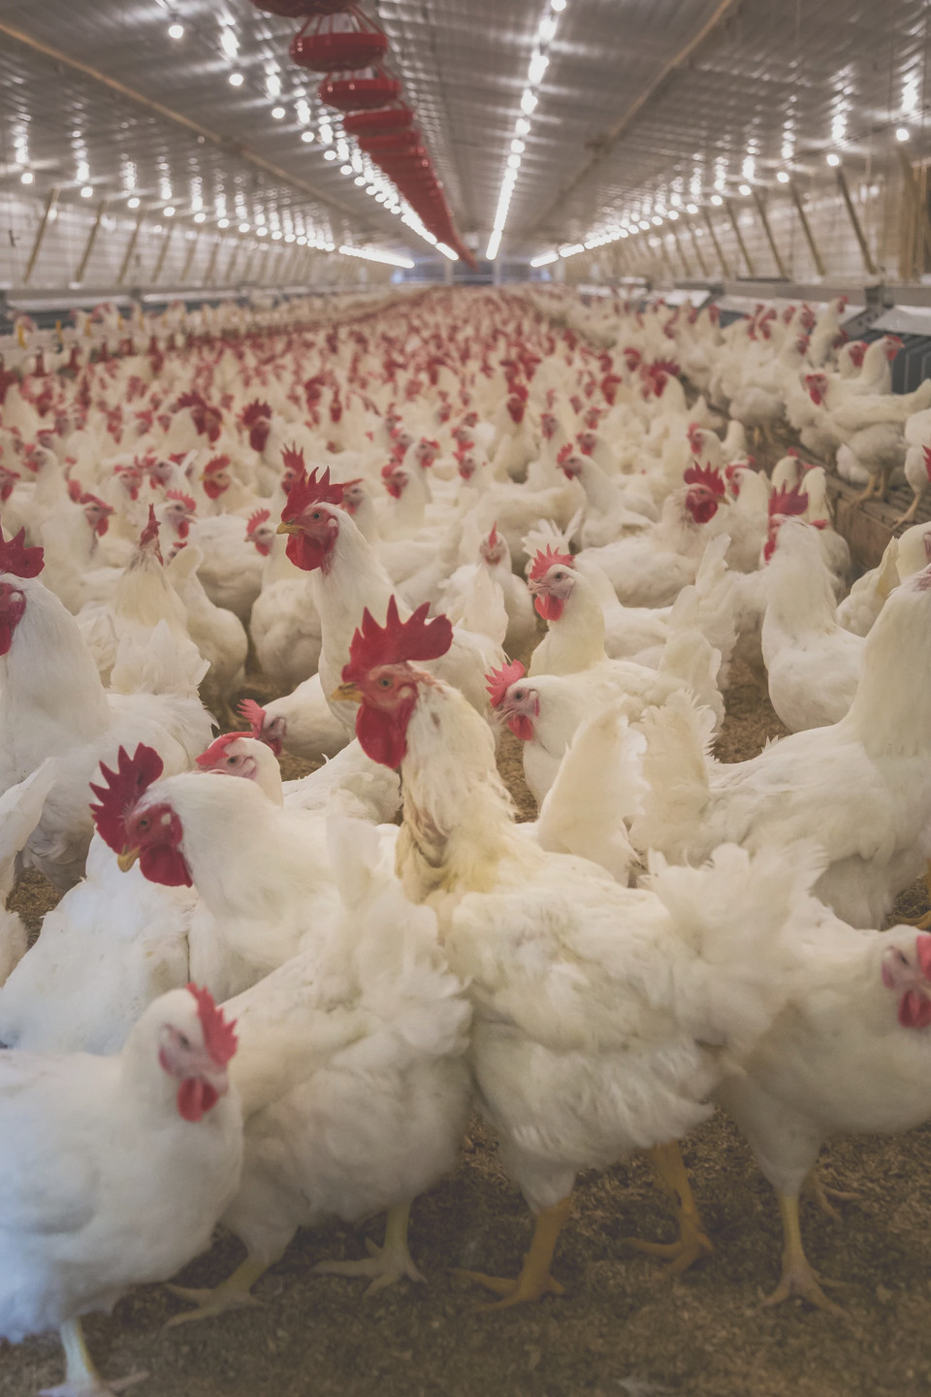
Antibiotic use in livestock
and poultry is increasing in LMICs
Purpose
Policy
Outcome
Growth promotion, infection prevention
& control
Often put in feed at low doses for non-therapeutic uses
Only recently regulated in U.S. & Europe, policies are weak
Unregulated in many LMICs (low-/middle-income countries)
Important antibiotics for human medicine are used to raise livestock & poultry
Emergence & selection of drug-resistant bacteria
Antibiotic resistant bacteria spread to farmworkers & in environment through manure contamination

Slide 8
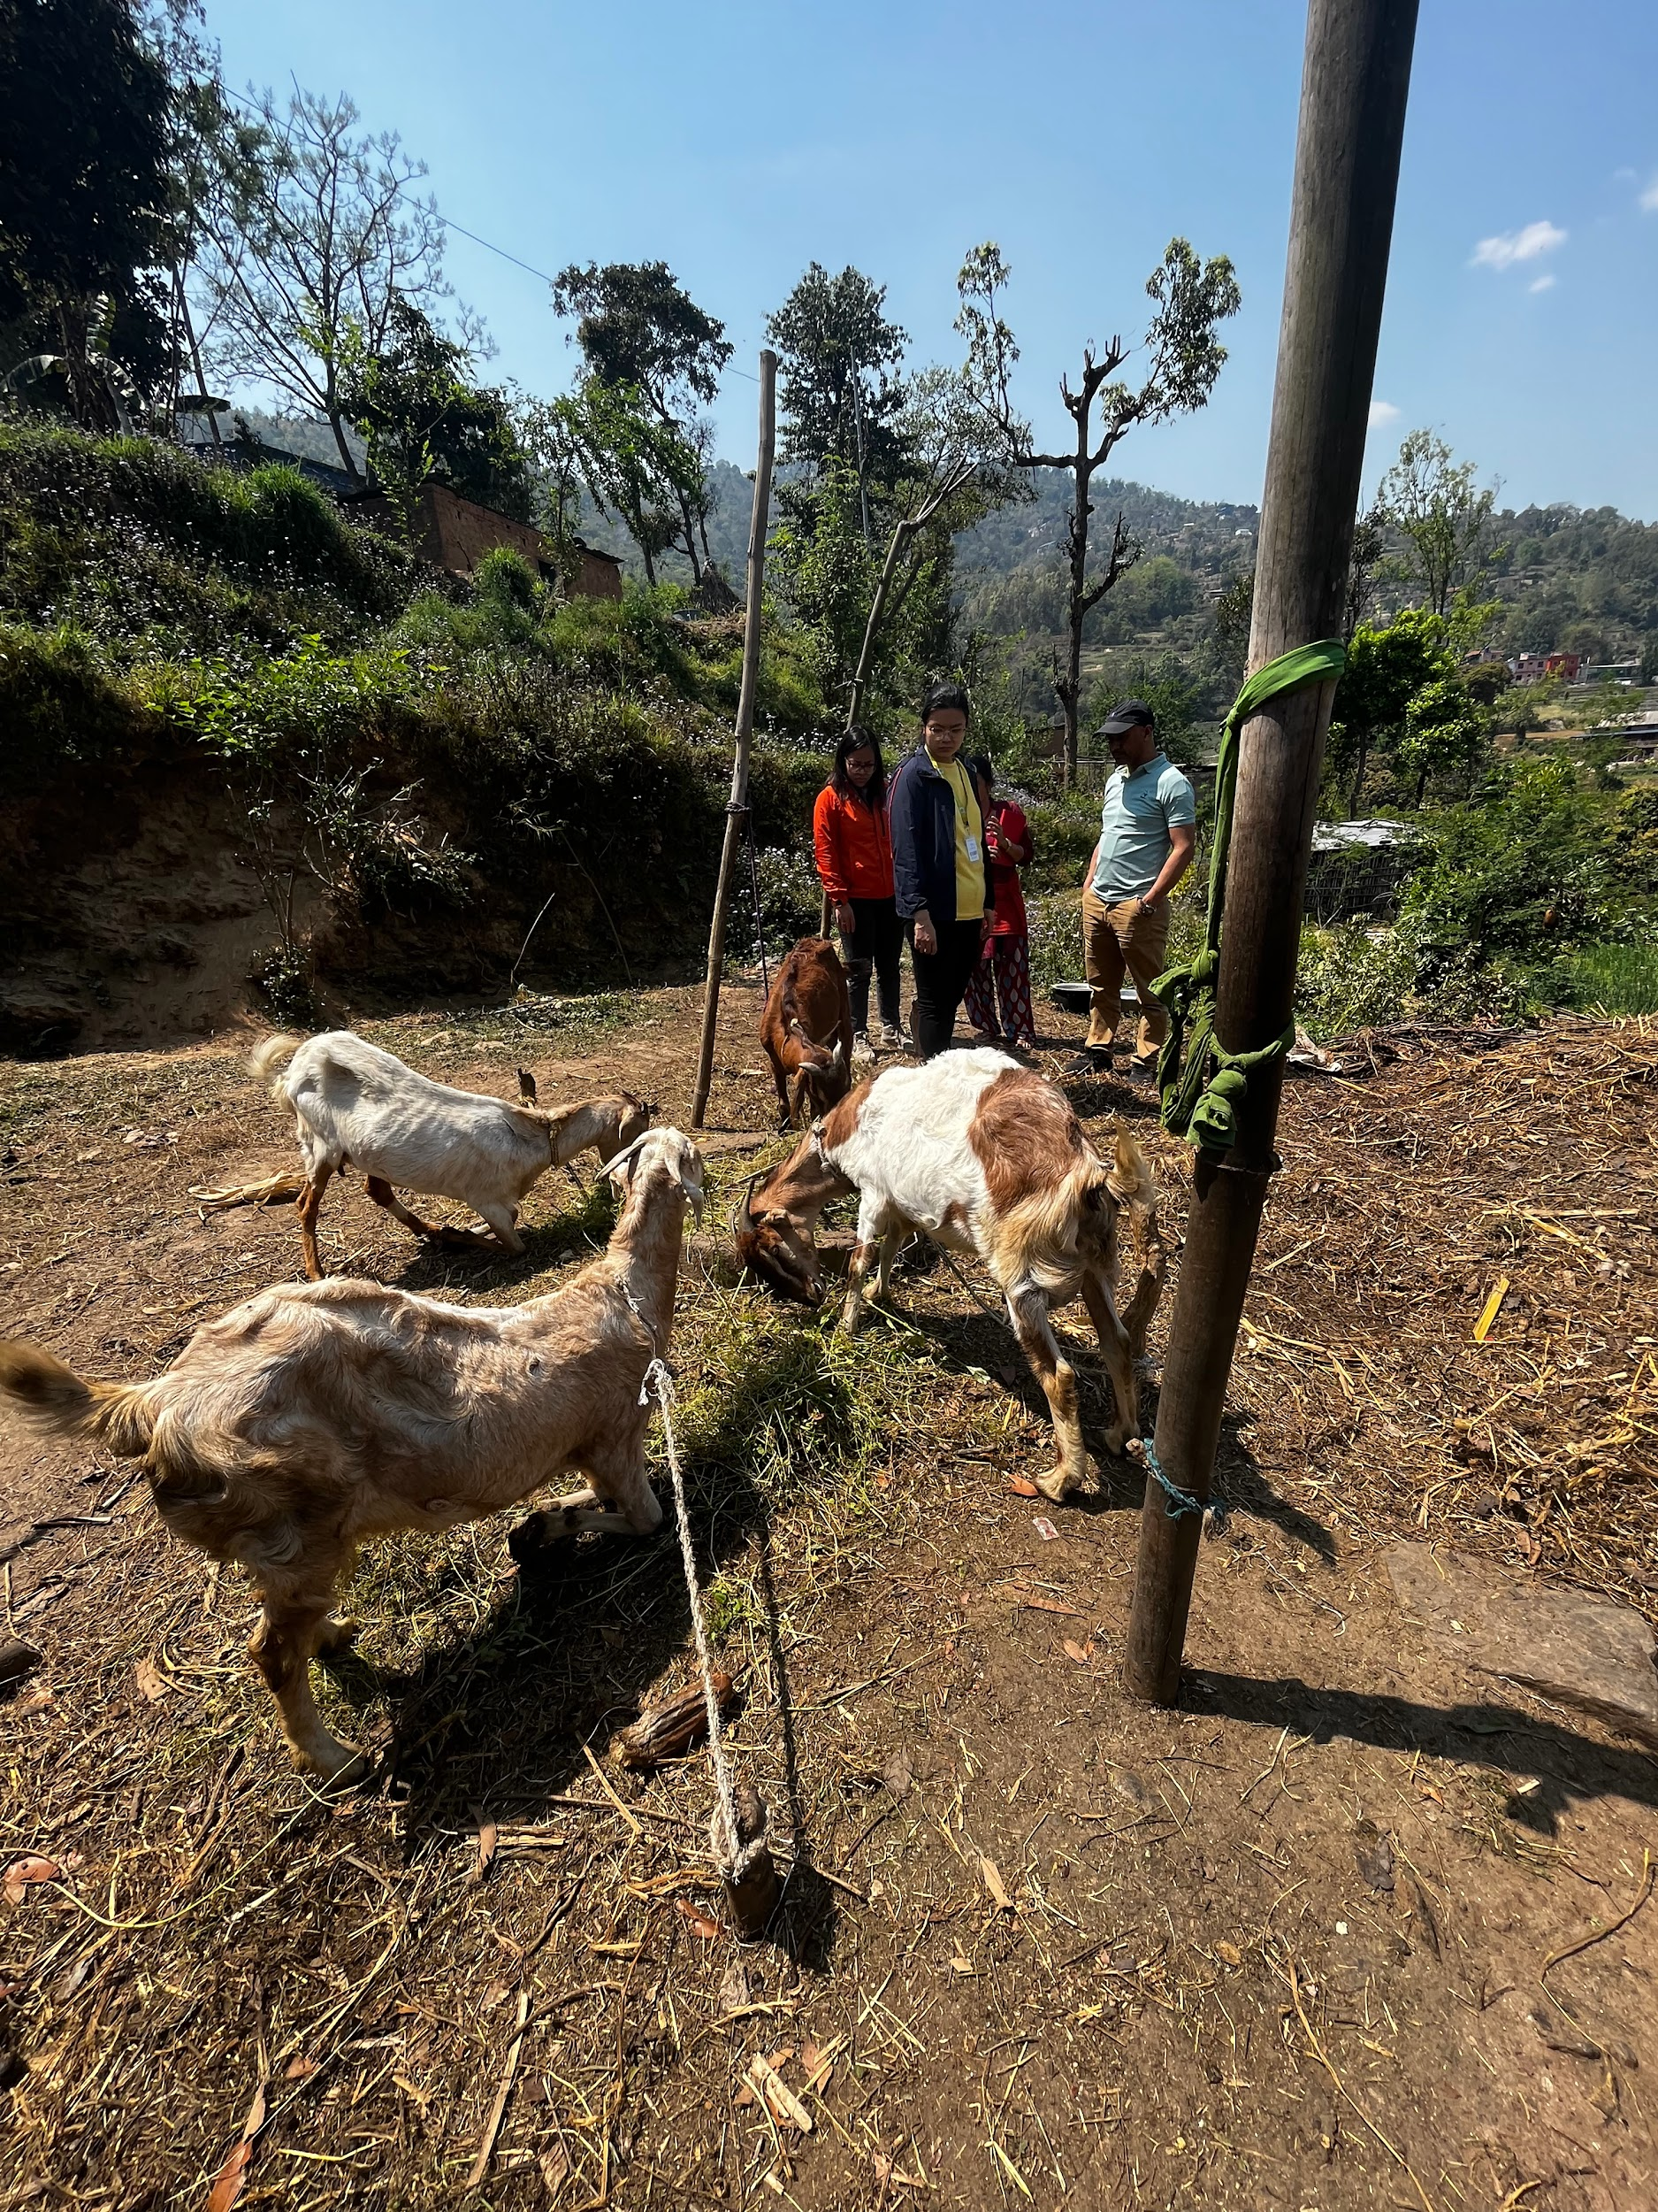
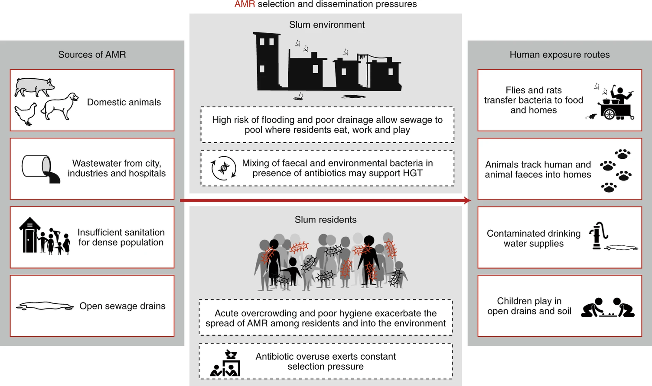
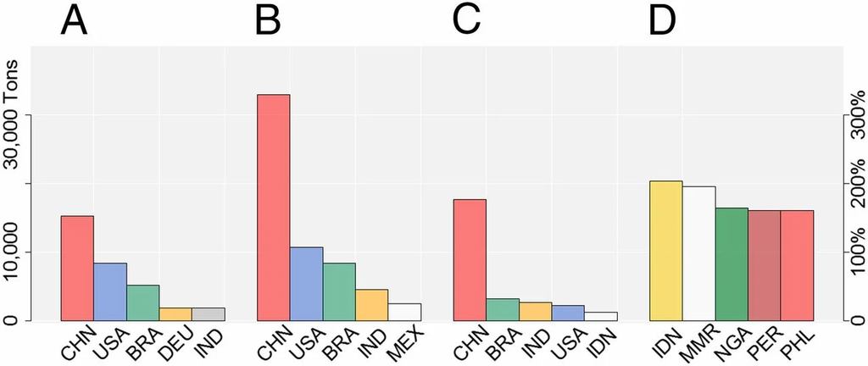
Drivers of AMR transmission in low-resource settings
Sociocultural and socioeconomic factors
Subsistence farming & backyard livestock
Limited knowledge of indiscriminate use of antibiotics
Environmental factors
Water, sanitation, hygiene
Waste management
Built environment
Countries with greatest estimated increase in antibiotic use for livestock from 2010-2030
absolute
increase
relative
increase
Van Boeckel et al. 2015 PNAS
Nadimpalli et al. 2020 Nature Microbiology

Slide 9
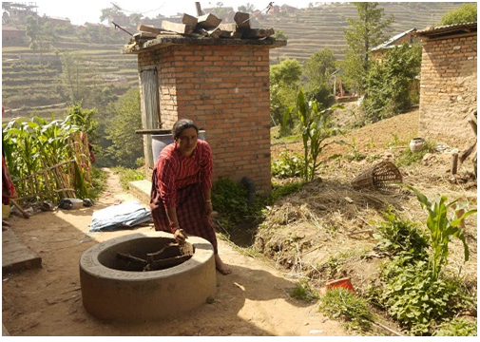
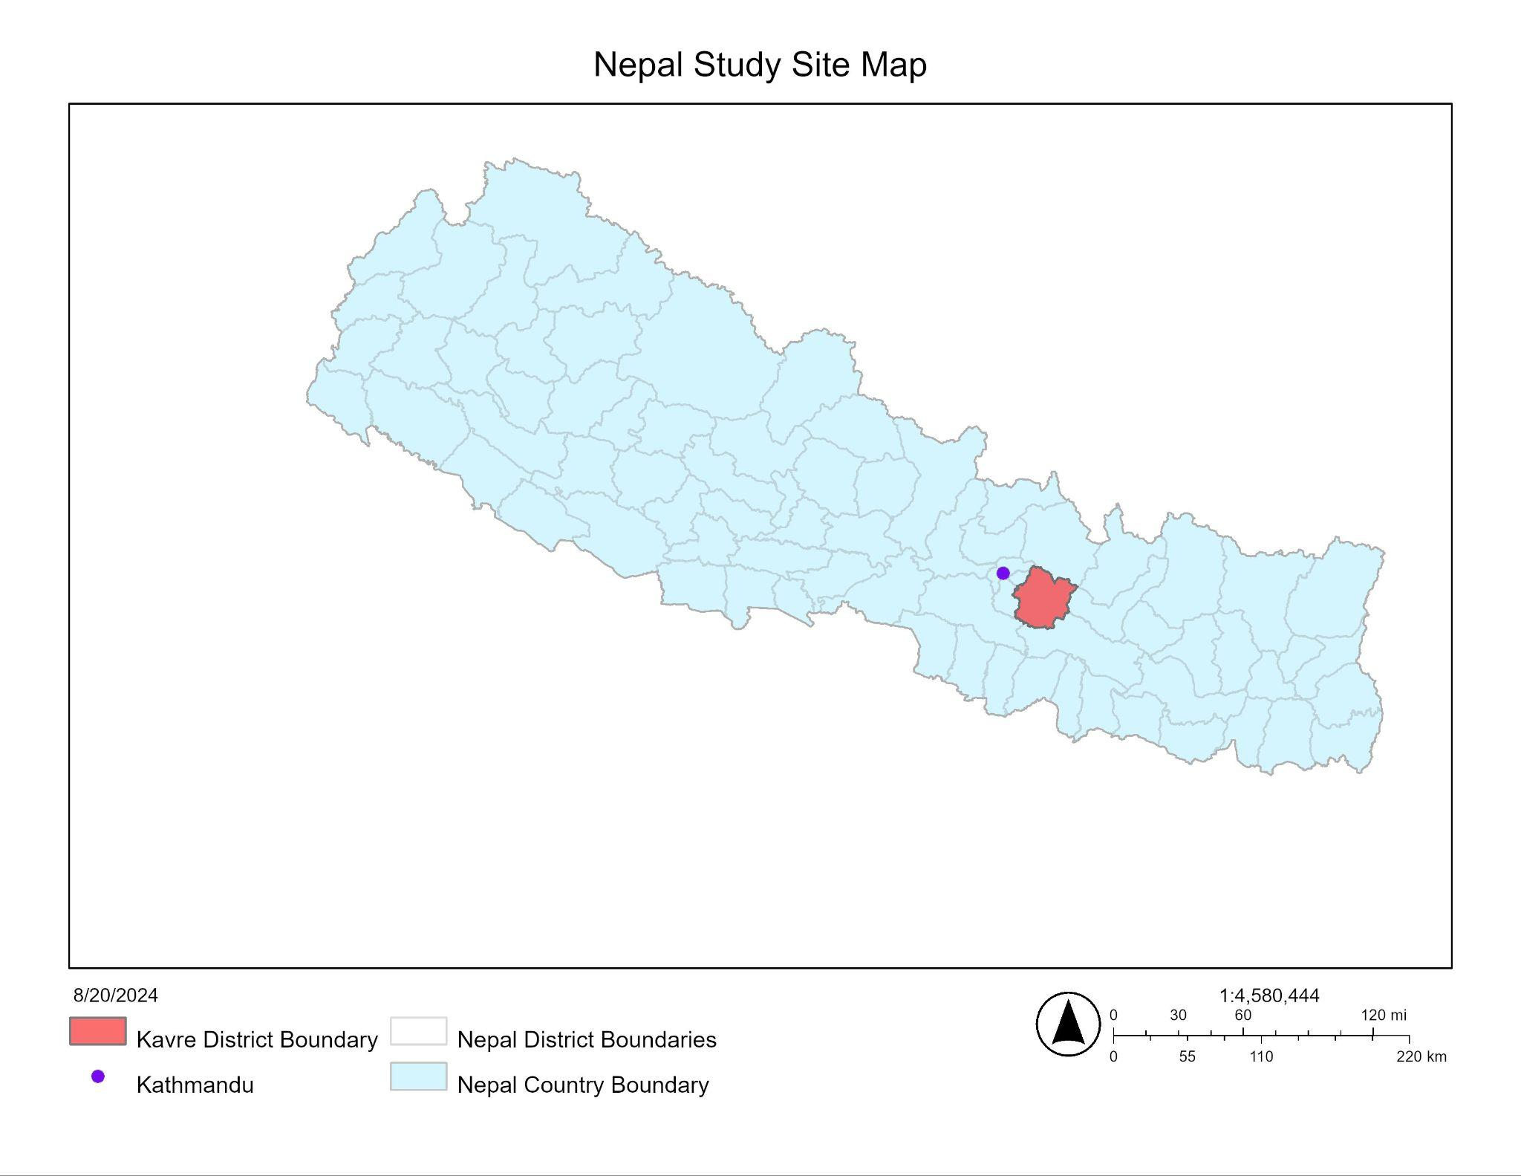
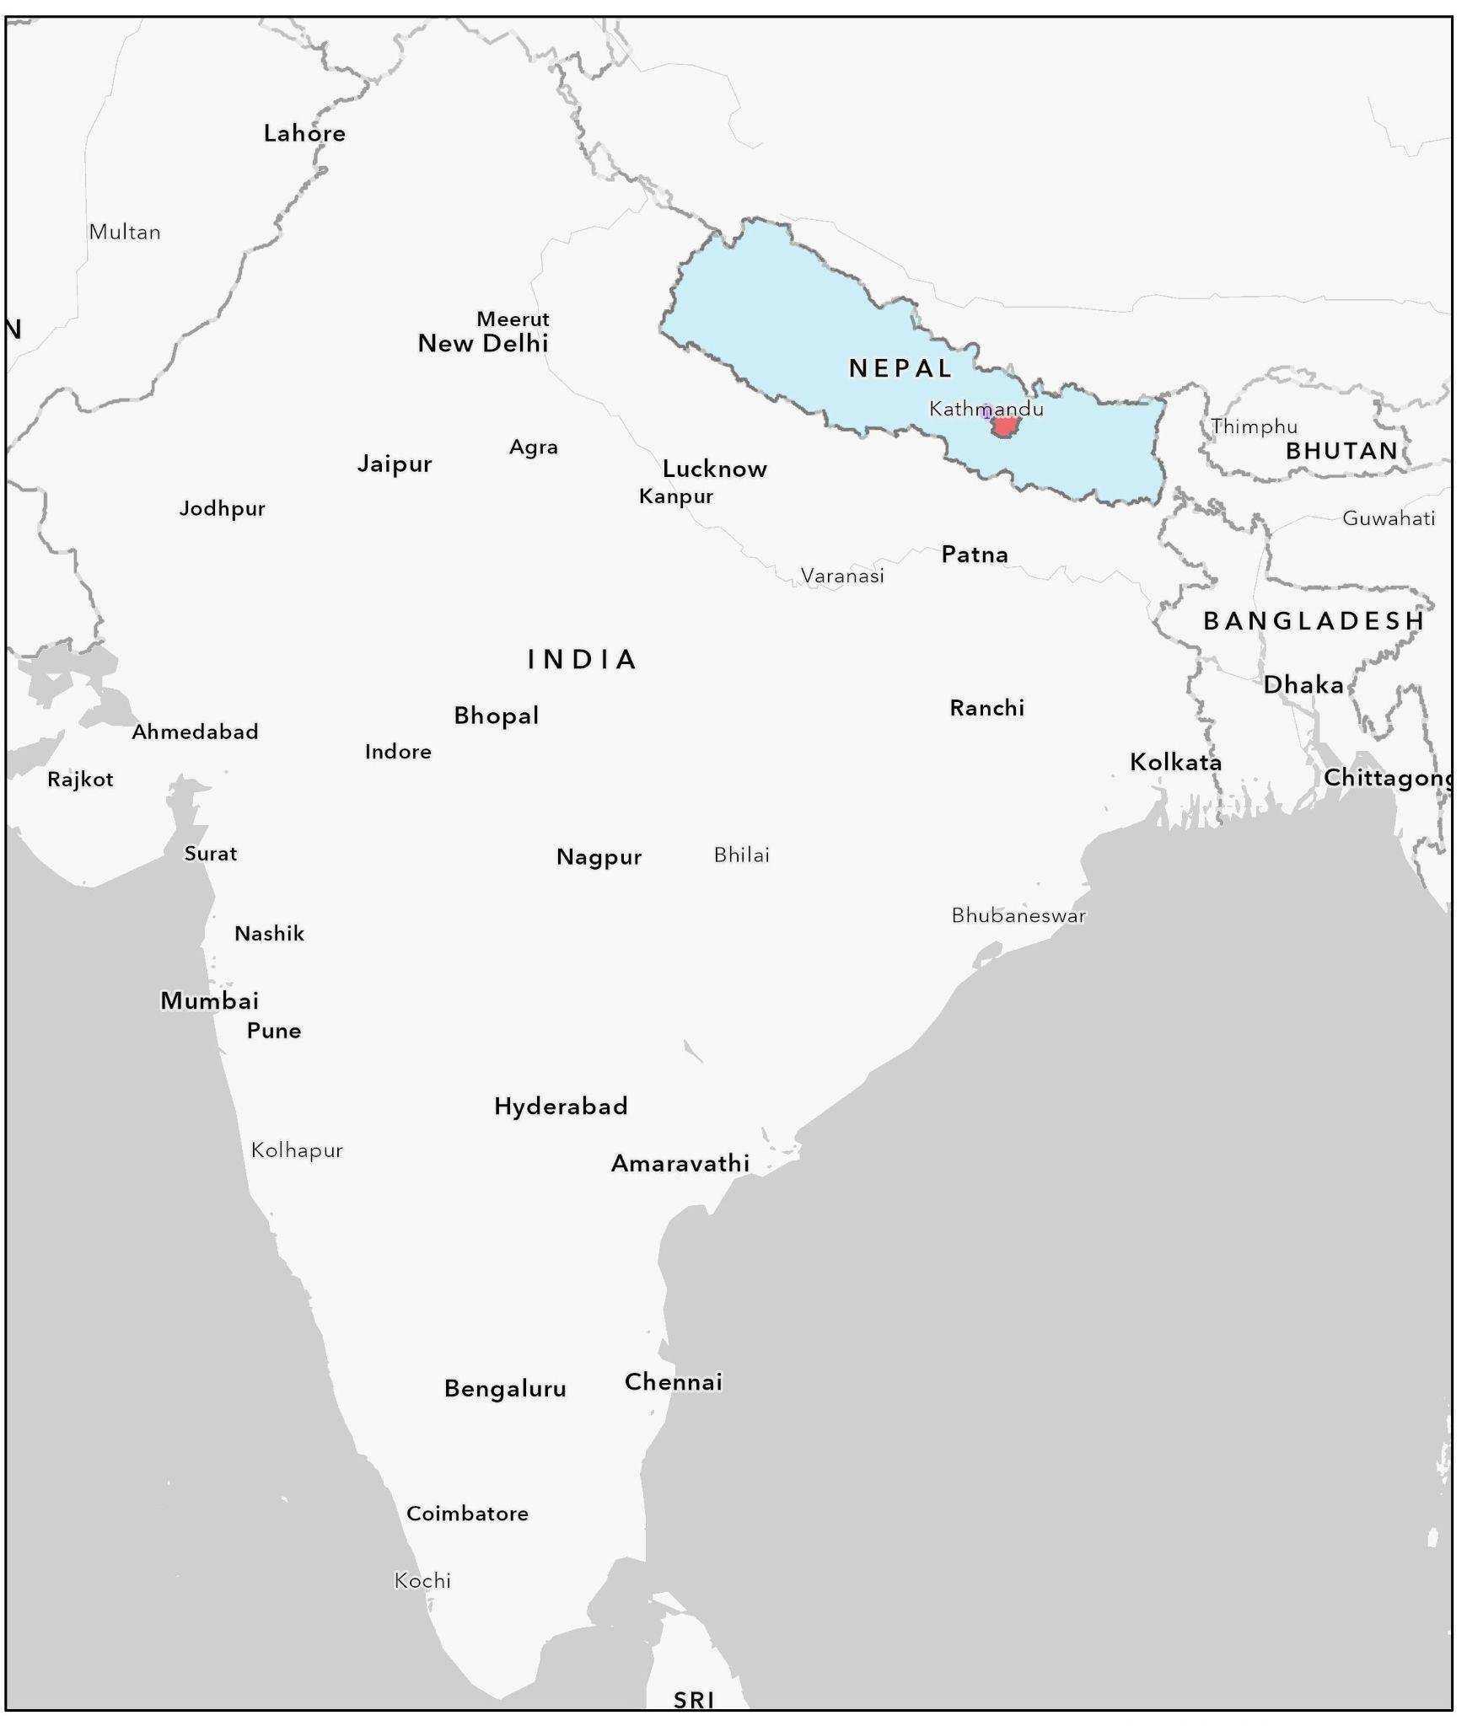
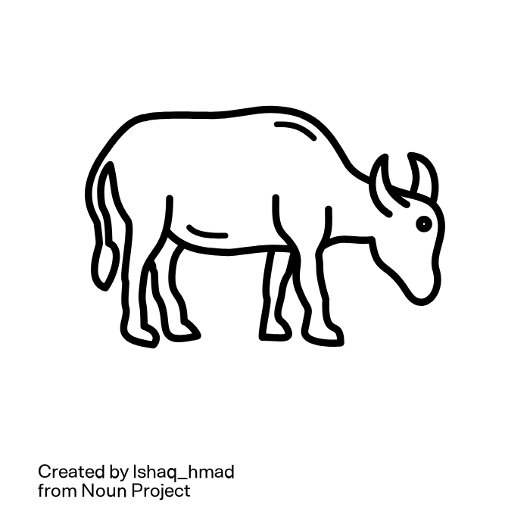





Animal waste
management in
rural Nepal
Kavrepalanchok District, Nepal
Source: Bay Area Nepali Women Organization
compost piles
anaerobic biodigesters
crop application

Slide 10
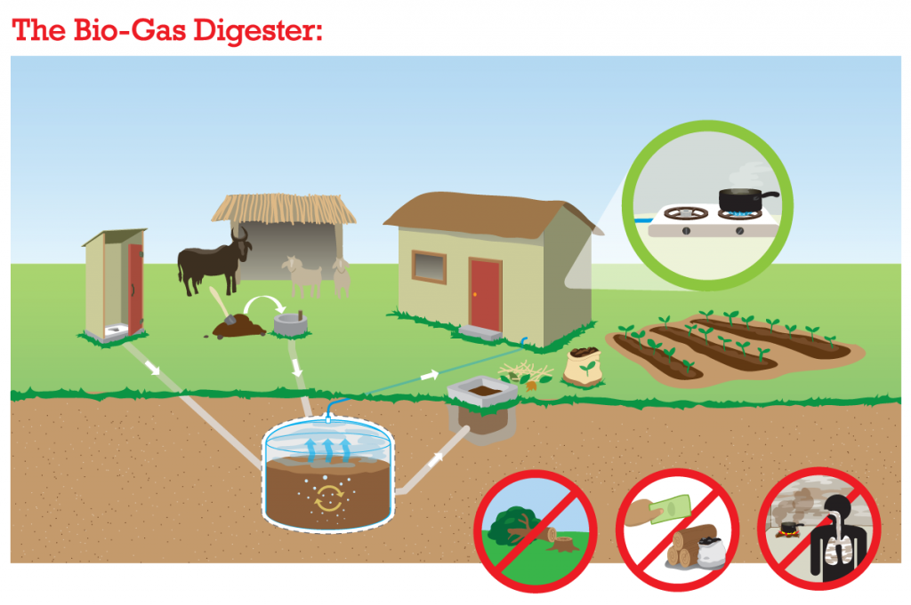
Household biodigester systems in Nepal
Replaced wood-burning stoves to reduce household air pollution and the risk of respiratory infections
Other potential benefits:
Reduced deforestation
Methane capture & reuse
Reduced costs for firewood
Reuses waste as fertilizer
Containment of fecal waste ?
choicehumanitarian.org

Slide 11
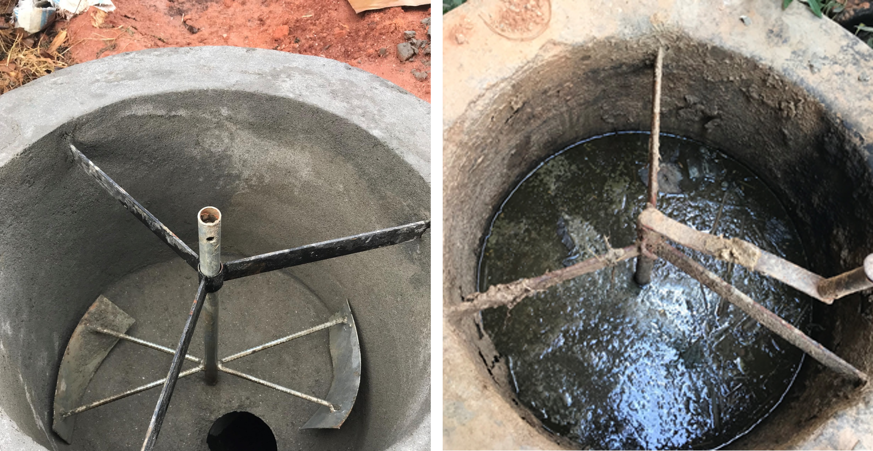
Exposures to animal waste and diarrheal disease
Use of biogas systems increased child diarrhea by 31%
Longitudinal PEER Health study of 560 households 2015-2017
Amato et al. 2022, Environmental Health Perspectives
Hypothesized fecal pathogen exposures through caregiver hands
Collecting animal feces by hand
Mixing slurry (waste + urine/water) by hand
Courtesy of Amod Pokhrel
Bay Area Nepali Women Organization

Slide 12
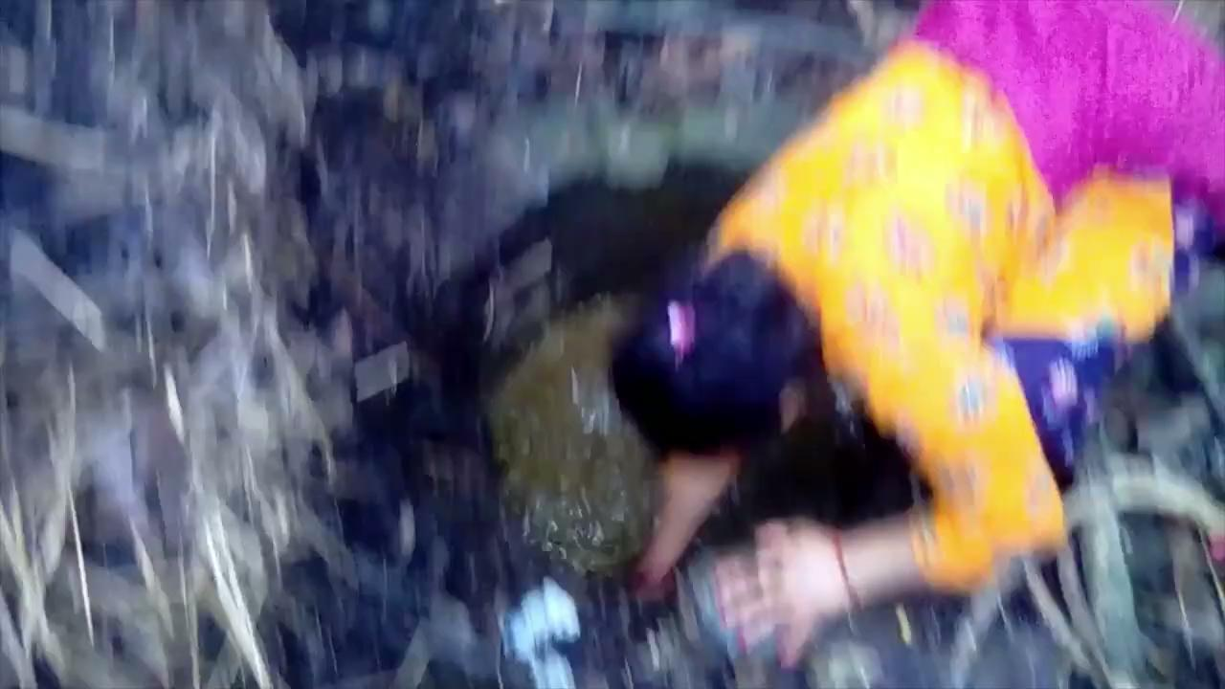

Slide 13
Exposures to animal waste likely indicate exposures to antimicrobial resistance (AMR)
Antibiotic use in & AMR in Nepal
Last-line antibiotics are commonly used in livestock and poultry (Koirala et al. 2021)
Knowledge and practices around appropriate use of antibiotics is limited (Lambrou et al. 2021)
AMR is prevalent in humans, livestock, and poultry in urban areas (Young et al. 2022)
High prevalence of multidrug-resistant infections (e.g., extended-spectrum beta-lactamase (ESBL)) (Dahal & Chaudhary, 2018)
Results in difficult-to-treat, dangerous infections

Slide 14
Research Questions
Does the environmental prevalence of resistant bacteria differ in households with vs. without biodigesters?
Are certain waste management strategies associated with increased antibiotic-resistant bacteria?
Is effluent from biodigesters safe to handle?
Does having a broken biodigester increase the risk of AMR exposures?

Slide 15
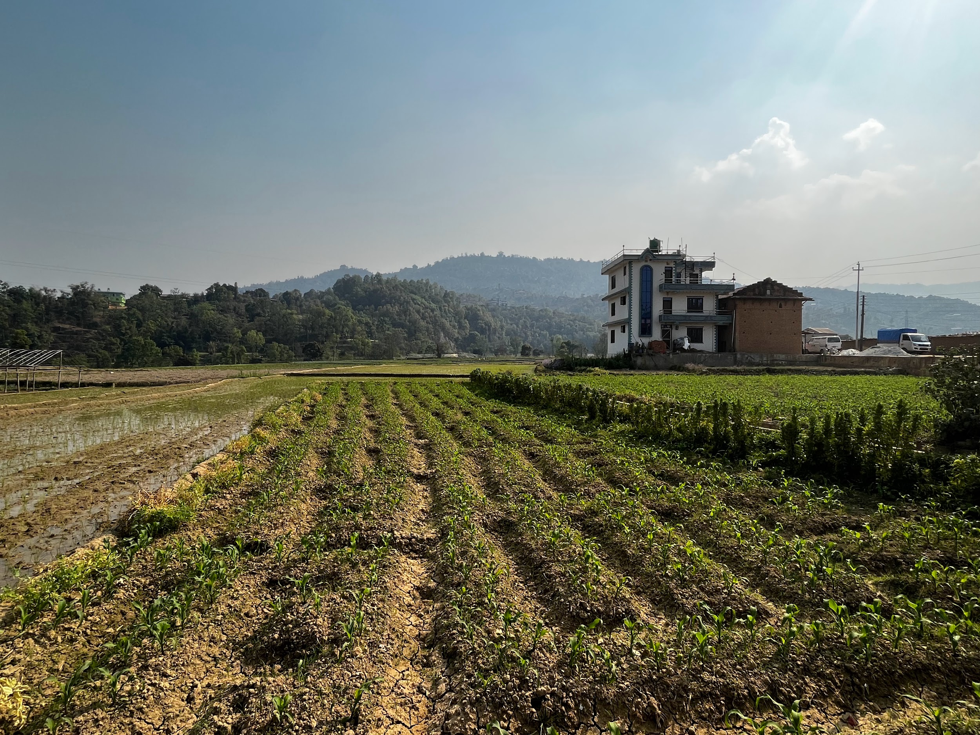
Fecal exposure pathways in Kavre
SAFER in Nepal: Studying Animal Fecal Exposures & Resistance
Cross-sectional study across 30 toles
301 households
child < 5 years
domestic animals/livestock
May-June 2023
Photo courtesy of Chris LeBoa
Notes:
Image is from Dhading District (similar and proximal to Kavre District)

Slide 16




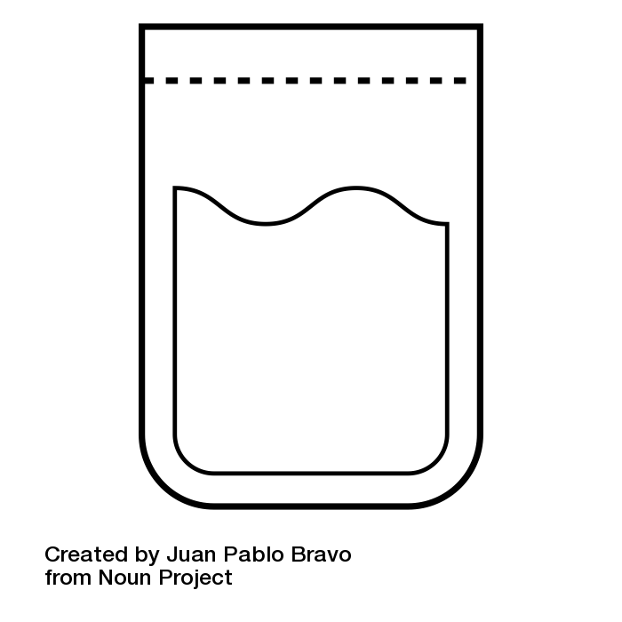



Data Collection
interviews & observations:
(N=301)
animal ownership
animal confinement
animal care/contact
animal waste management
samples to measure AMR :
(n=3-4 per household)
child & mother hand rinses
soil from child play area
biodigester effluent

Slide 17
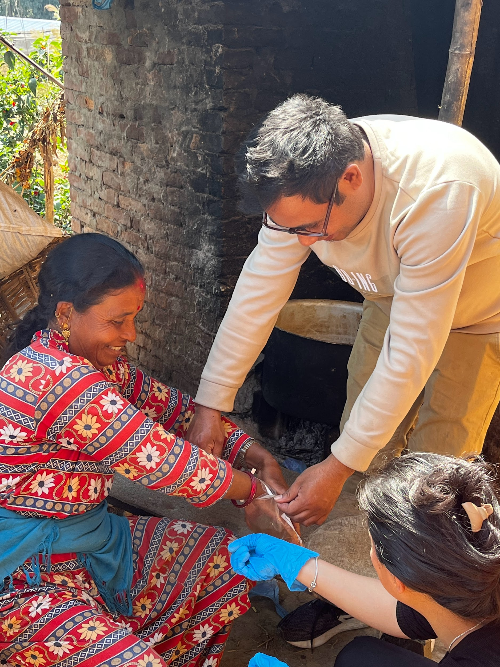
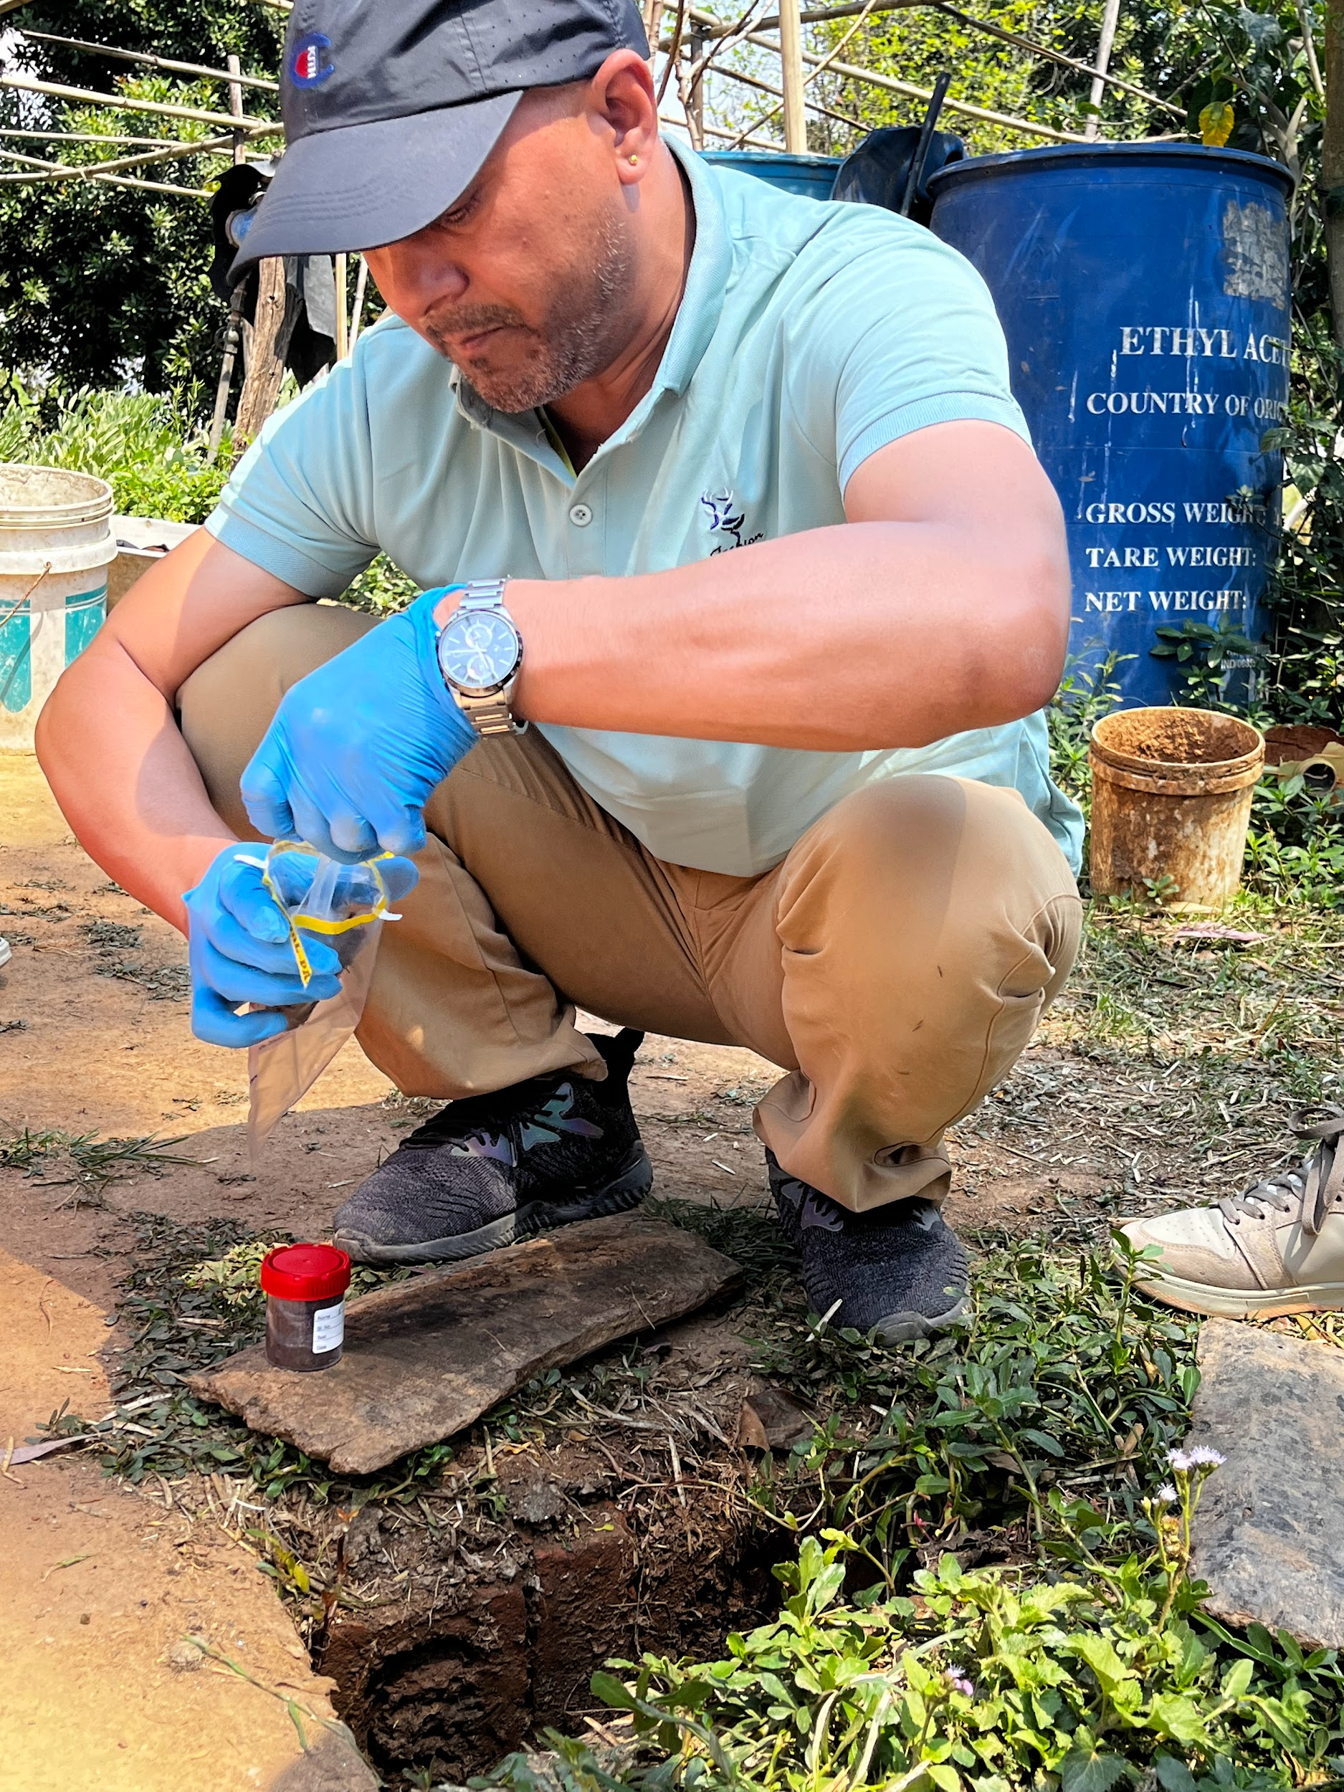
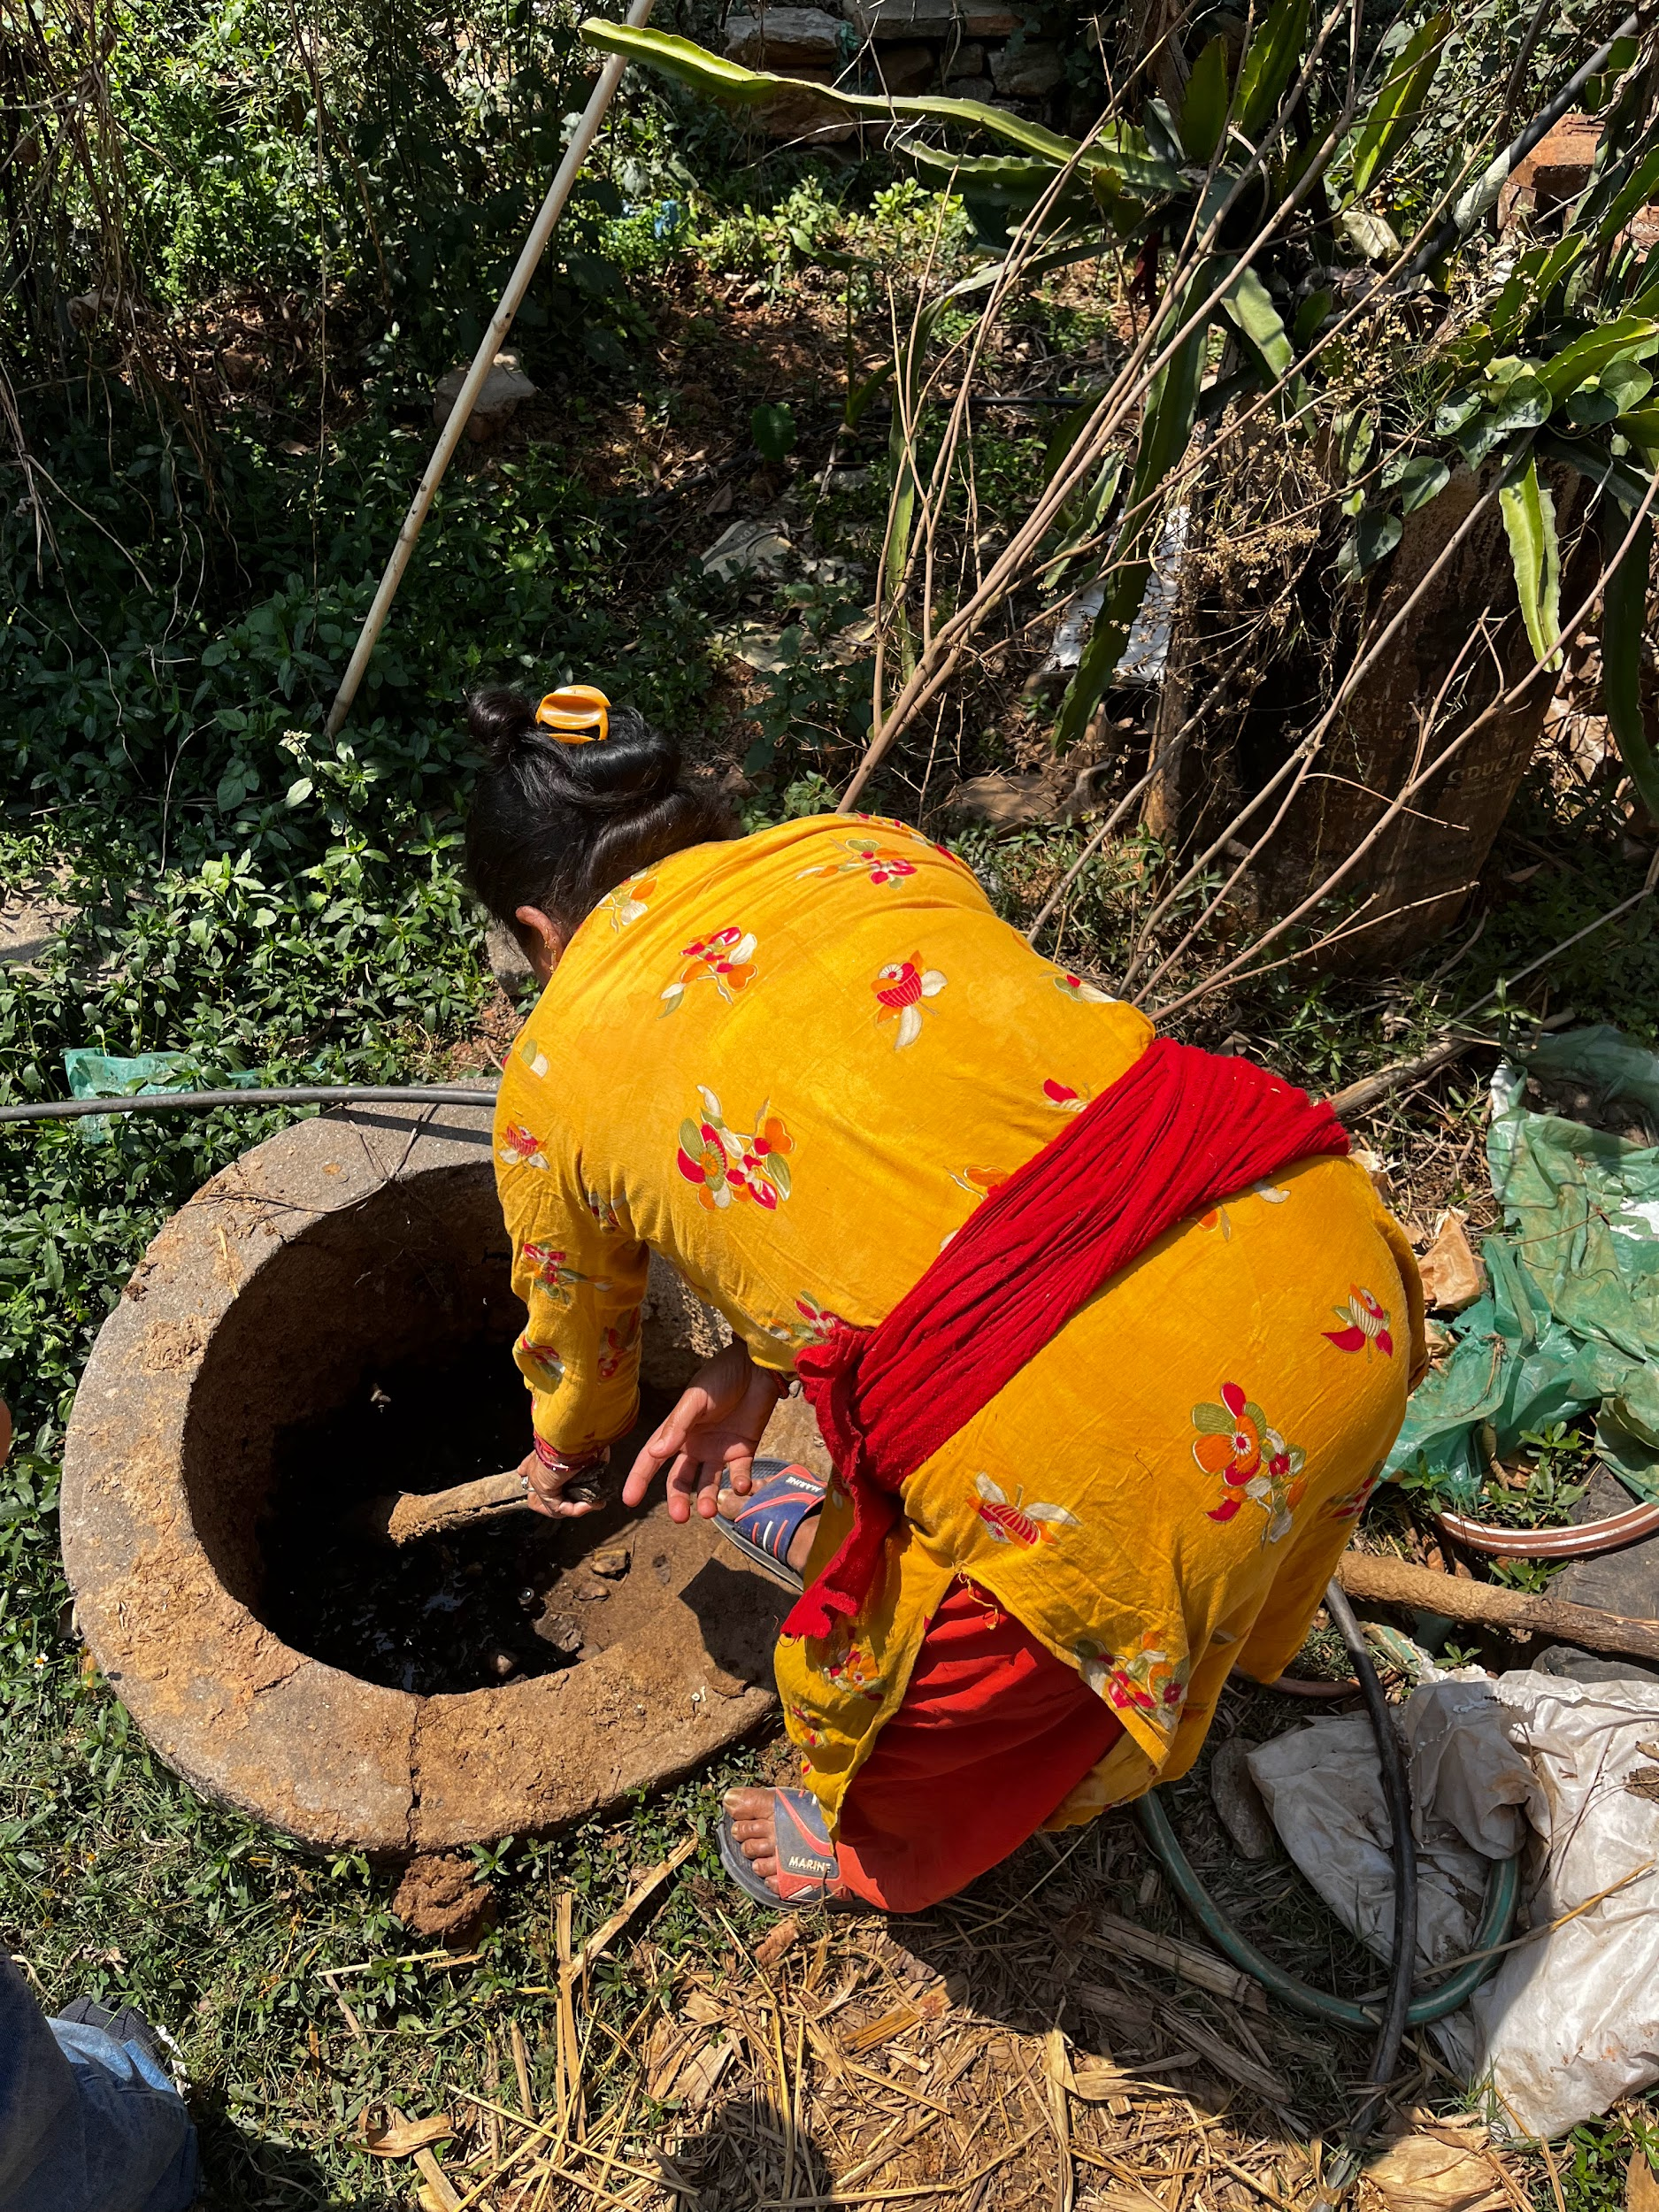
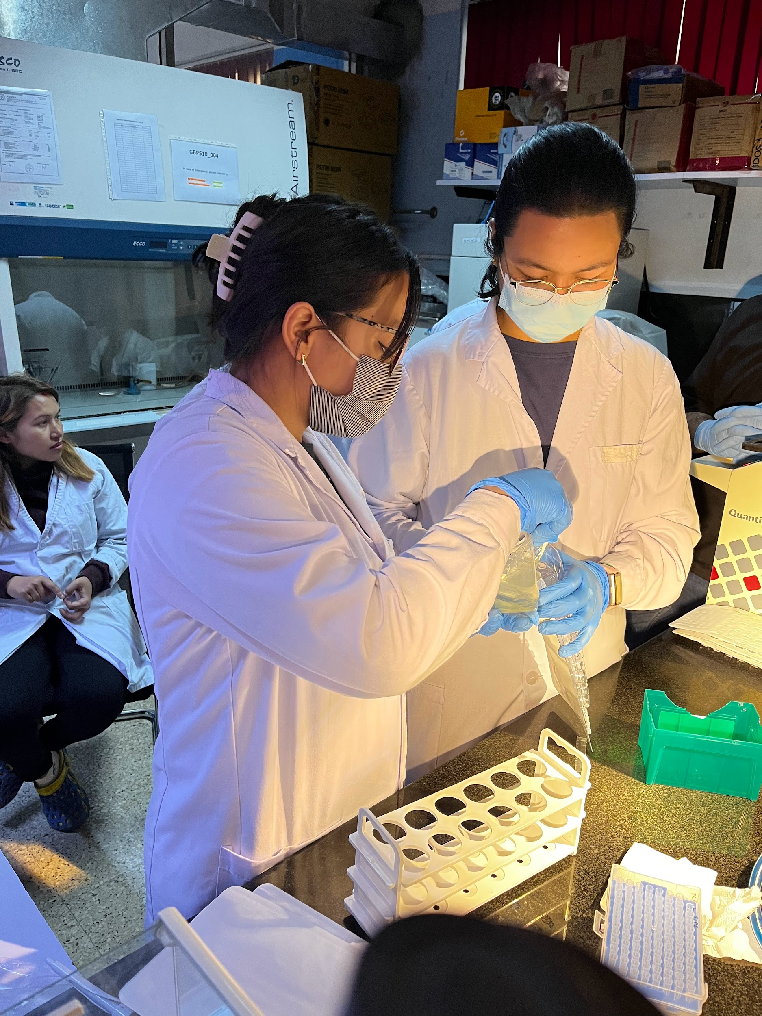

Slide 18
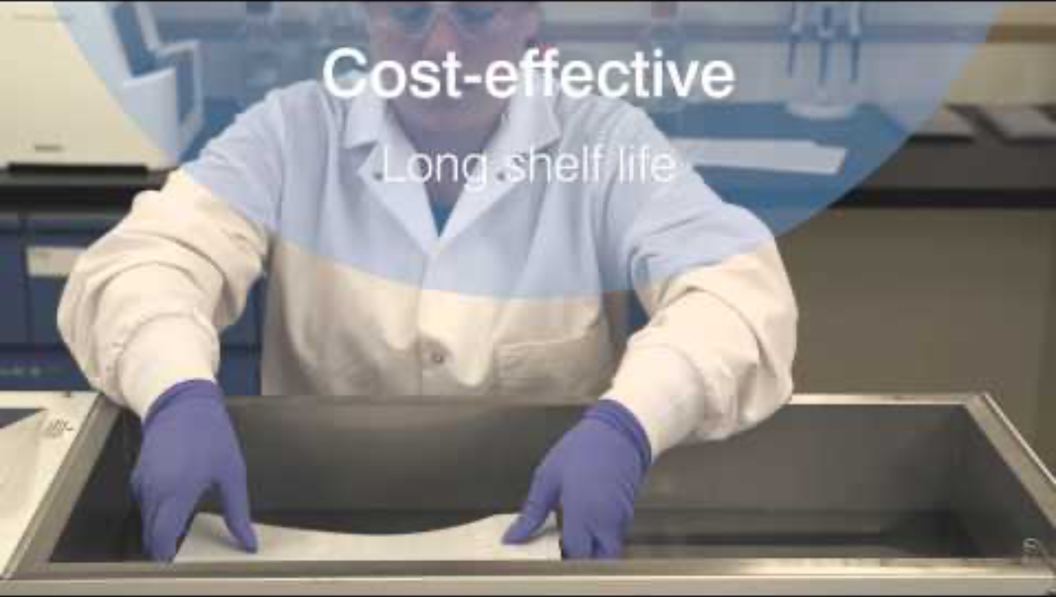
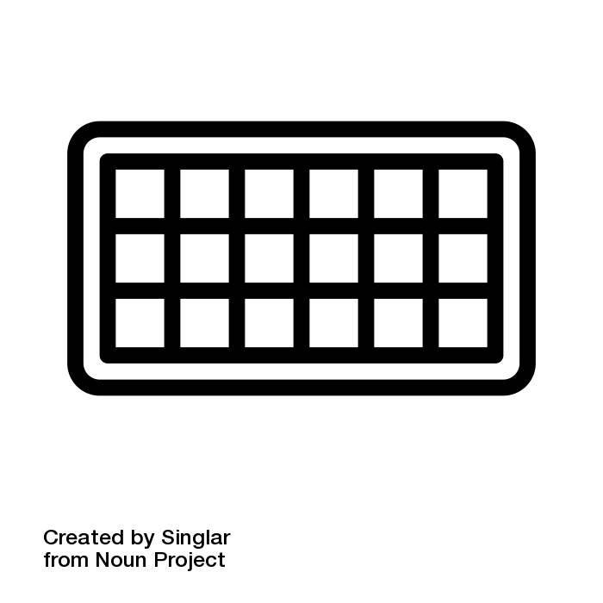
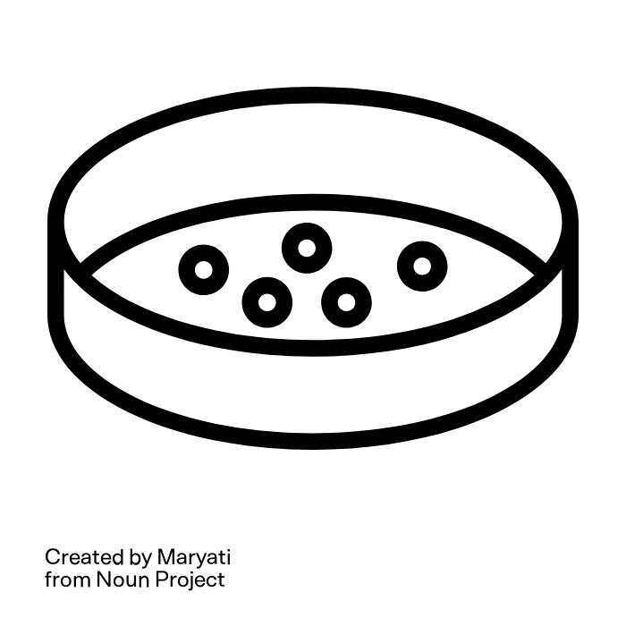
AMR detection and quantification
Quantification of fecal indicator bacteria with IDEXX and plating on selective media:
IDEXX QuantiTray 1:
Most Probable Number (MPN) of total coliform (TC) & E. coli
IDEXX QuantiTray 2:
MPN of cefotaxime-resistant TC & E. coli
Streaking plates:
Antibiotic susceptibility testing (AST) & confirmation of ESBL E. coli

Slide 19
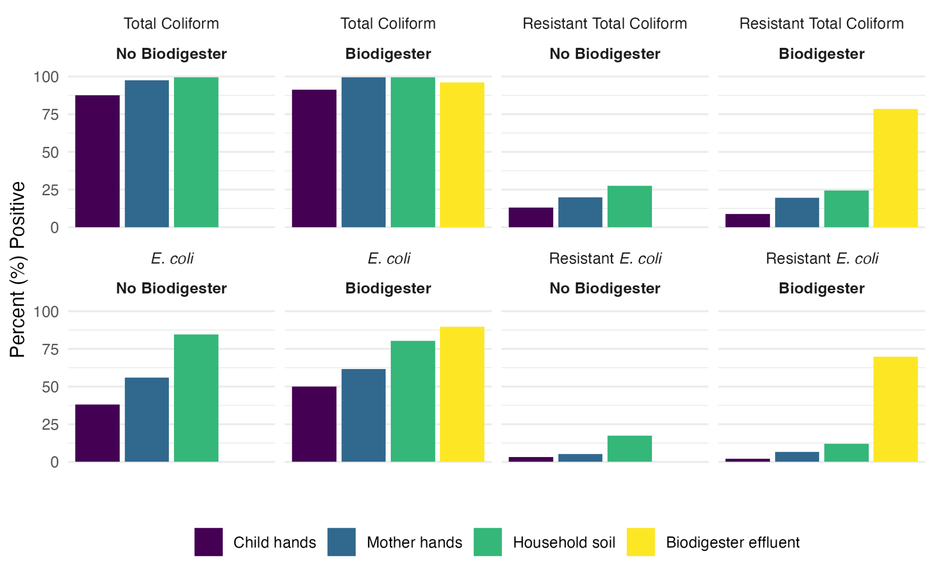
Does AMR exposure differ based on biodigester ownership?
Results
Total samples collected: N=1,025
20%
28%
20%
25%
13%
9%
p = 0.051
17%
12%
3%
5%
2%
7%
N=300 N=301 N=297

Slide 20
Is effluent from biodigesters safe to handle?
Results
Total samples collected: N=1,025
80%
20%
28%
20%
25%
13%
9%
p = 0.051
72%
17%
12%
3%
5%
2%
7%
N=300 N=301 N=297 N=127

Slide 21
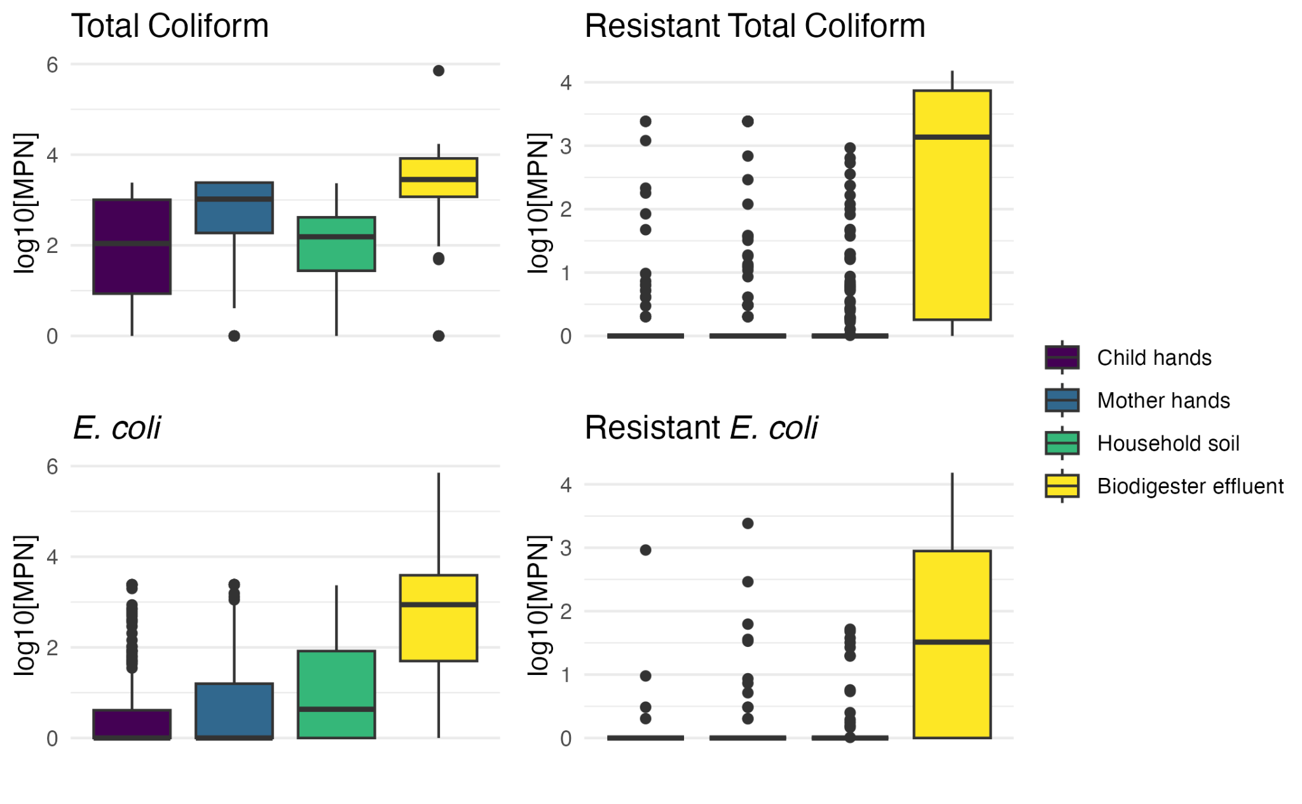
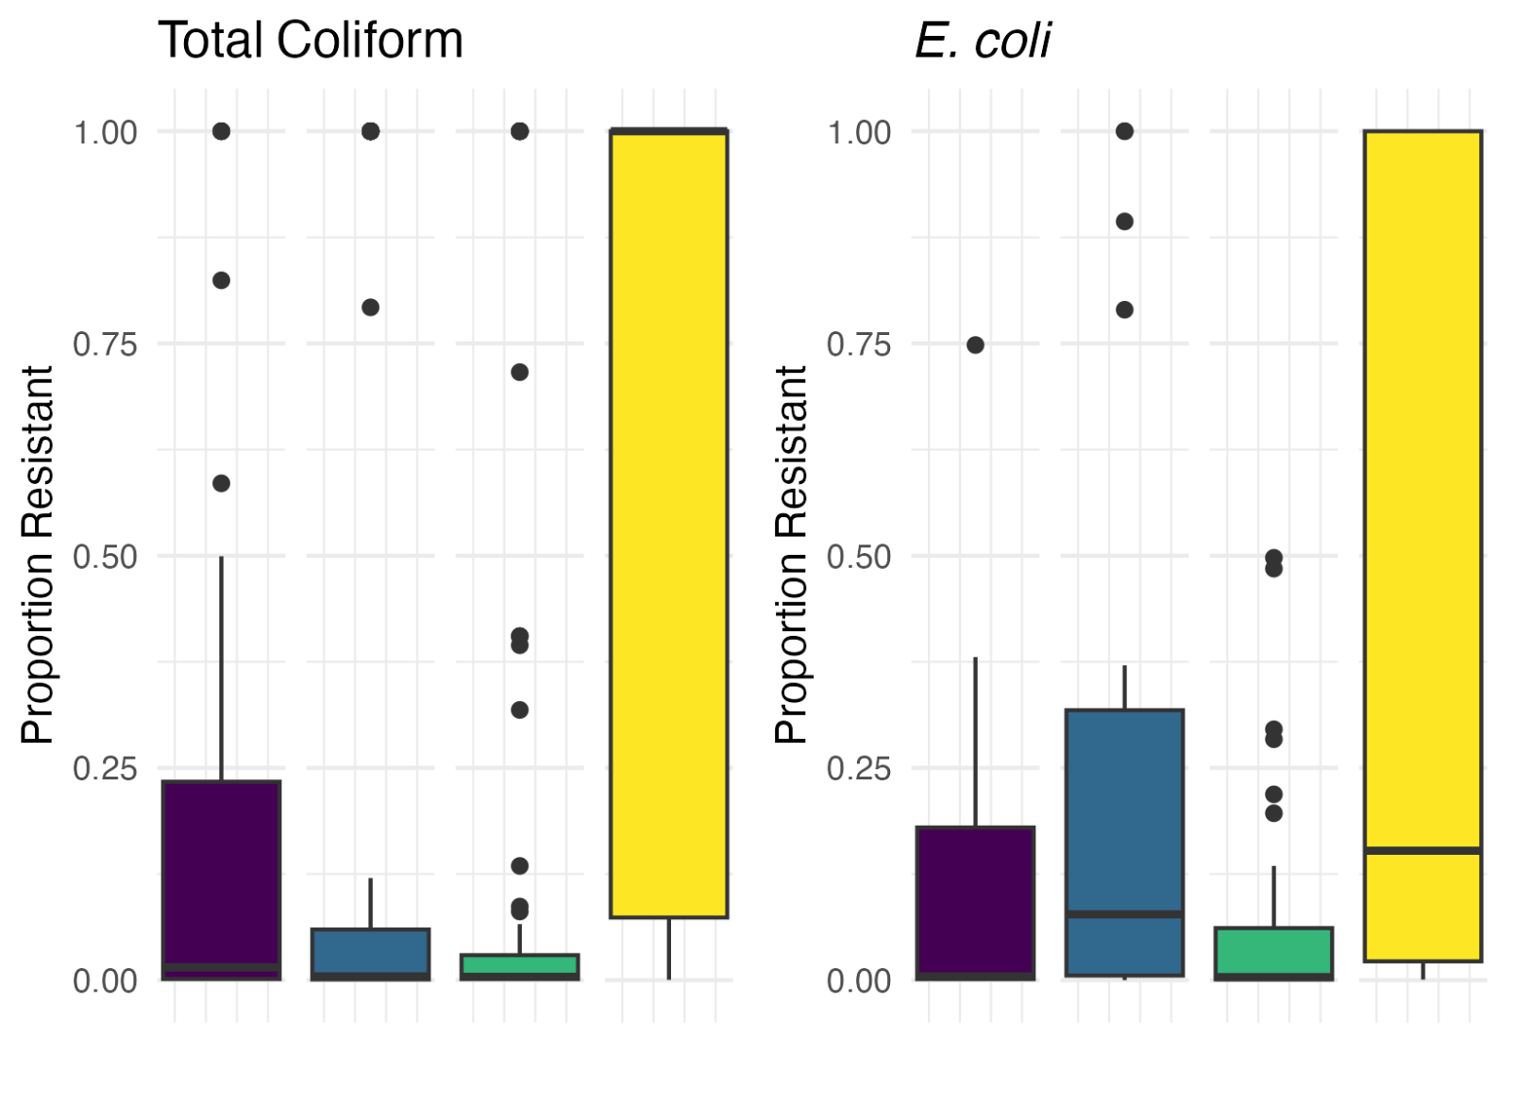
Is effluent from biodigesters safe to handle?
Results
Levels of fecal bacteria & cefotaxime-resistant bacteria
(including all samples)
Proportion of bacteria resistant to cefotaxime
(excluding samples without resistance)
N=33 N=59 N=77 N=99
N=8 N=18 N=44 N=88

Slide 22
Is effluent from biodigesters safe to handle?
Extended-spectrum beta-lactamase (ESBL) E. coli
20% of household soil samples
No difference between biodigester and non-biodigester households
35% of effluent samples
Consistent with ESBL prevalence from household sewage in Nepal (Subramanya et al. 2021)

Slide 23
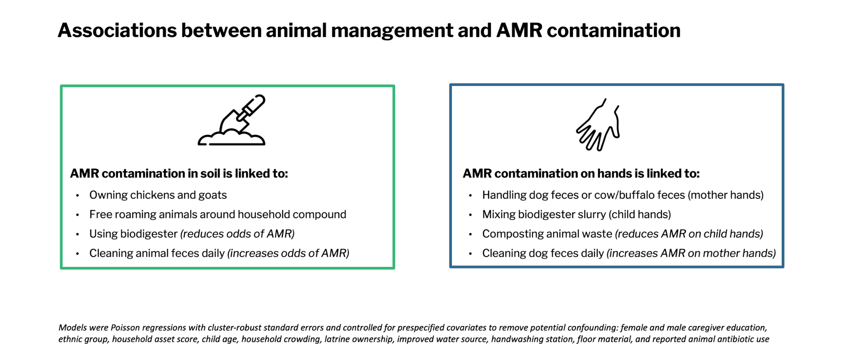
Factors associated with resistant bacteria?

Slide 24
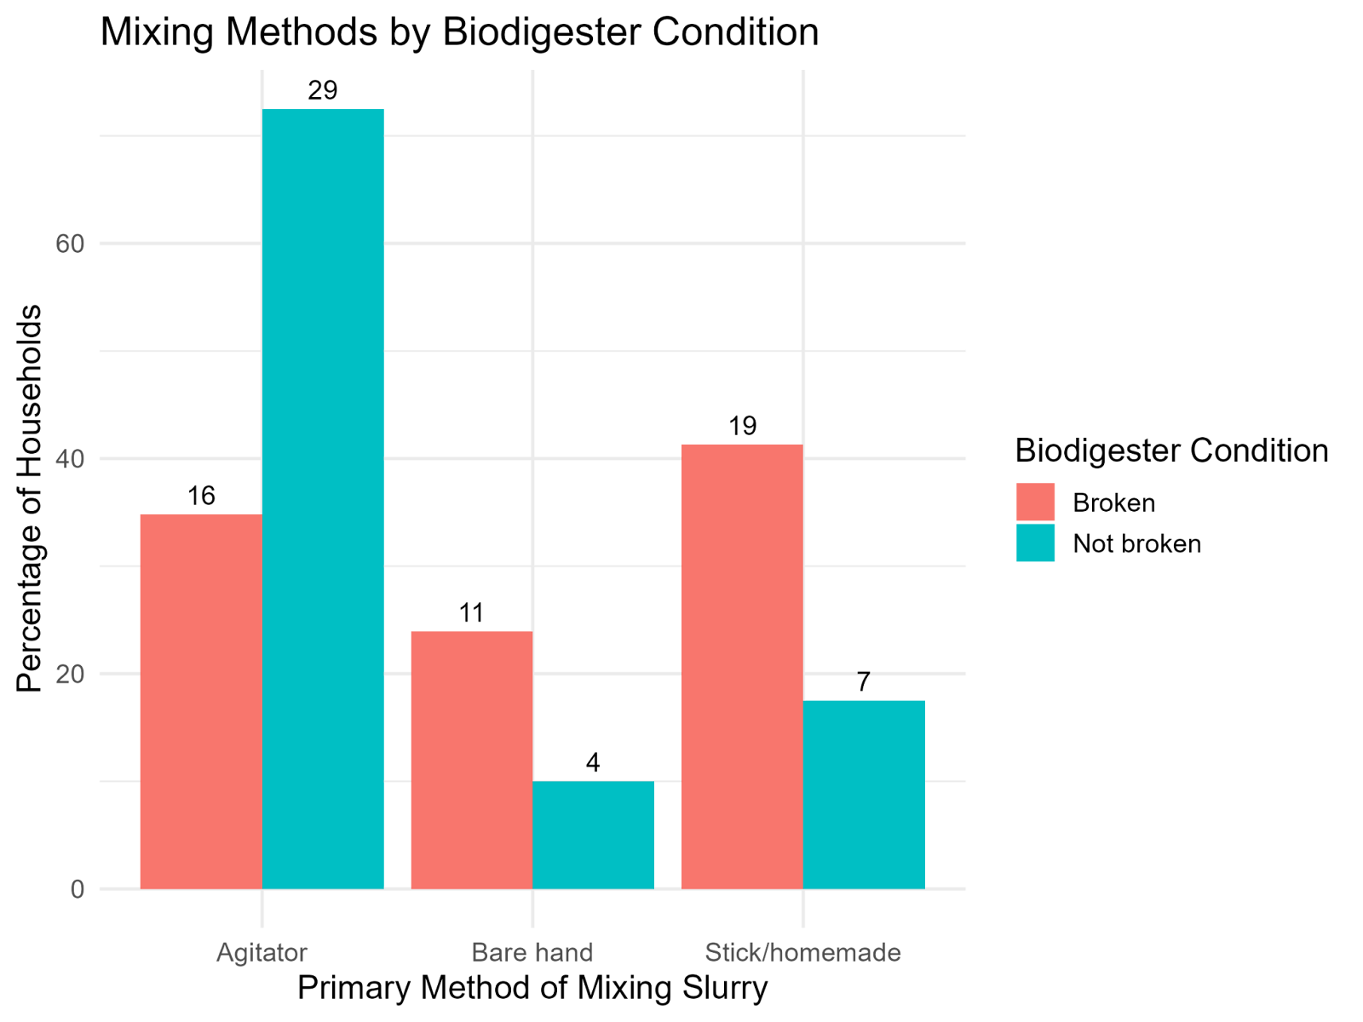
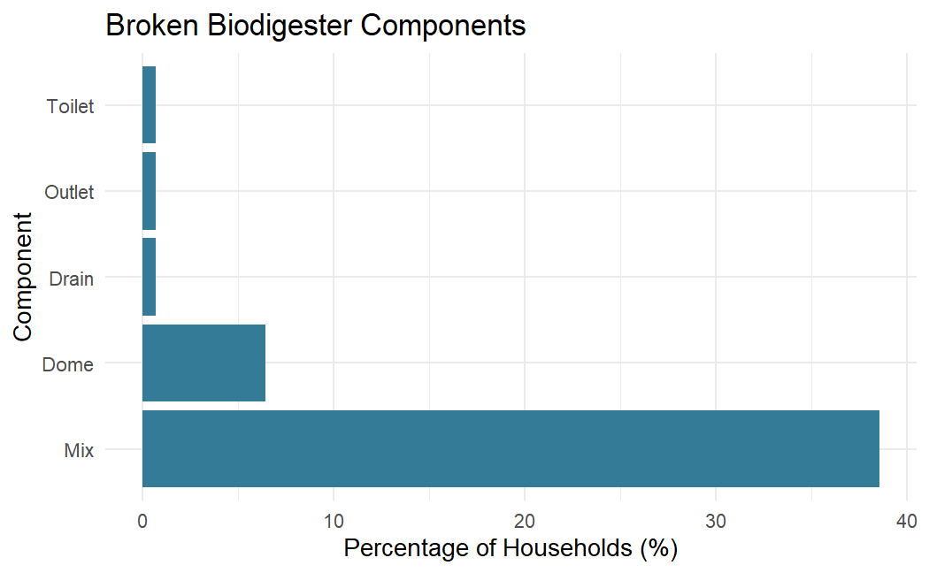
Broken Biodigesters
Does having a broken biodigester increase the risk of AMR exposures?

Slide 25
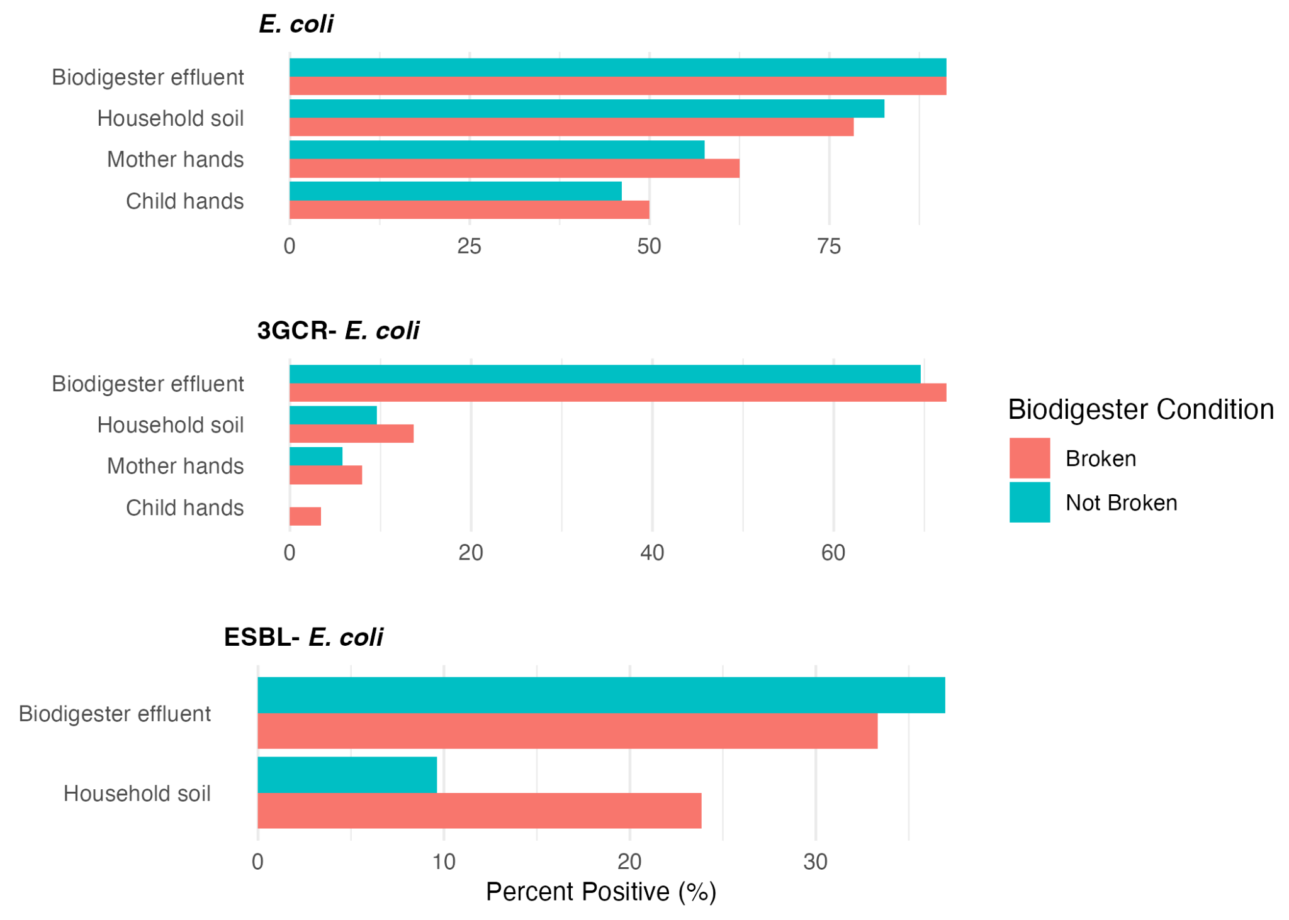
AMR is higher in soil when biodigester is broken
Does having a broken biodigester increase the risk of AMR exposures?

Slide 26
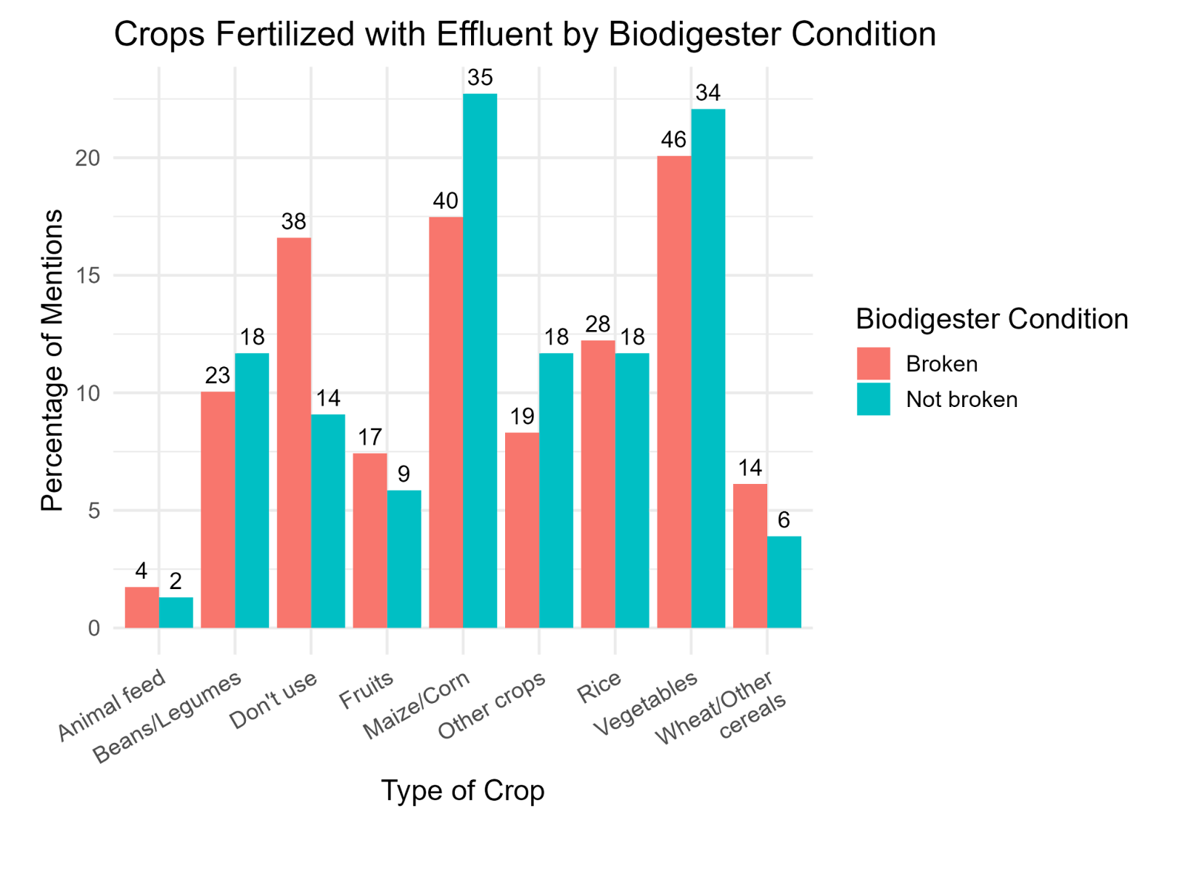
Application of biodigester effluent on crops
Does having a broken biodigester increase the risk of AMR exposures?

Slide 27
Now what?
Further research questions
1. Beyond AMR, what other infectious pathogens are people exposed to in rural household environments?
2. Is produce treated with biodigester effluent a potential source of AMR and pathogens?
3. Is handling compost with animal waste also a potential source of AMR and pathogens?
3. Are water, animals, sanitation, and hygiene (WASH) factors related to AMR and pathogen burden?

Slide 28
Now what?
Further research questions
1. Beyond AMR, what other infectious pathogens are people exposed to in rural household environments?
2. Is produce treated with biodigester effluent a potential source of AMR and pathogens?
3. Is handling compost with animal waste also a potential source of AMR and pathogens?
3. Are water, animals, sanitation, and hygiene (WASH) factors related to AMR and pathogen burden?
Follow-up research (hypothetical study for this workshop)
Collect compost piles, effluent, and produce samples from 140 household to determine how levels of AMR change through the collection and application process
Use qPCR array cards to characterize risks of exposure to a broad range of pathogens
Identify factors driving high levels of resistant bacteria and pathogens along these key exposure pathways by linking pathogen data to survey data

Slide 29
Introduction to TacMan Array Cards (TAC)

Slide 30
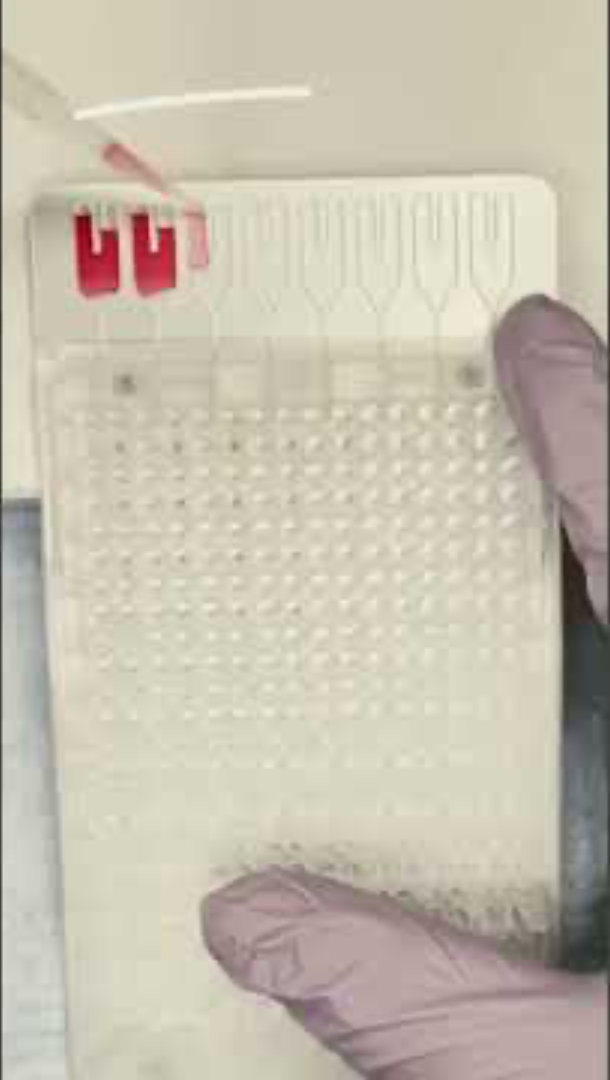
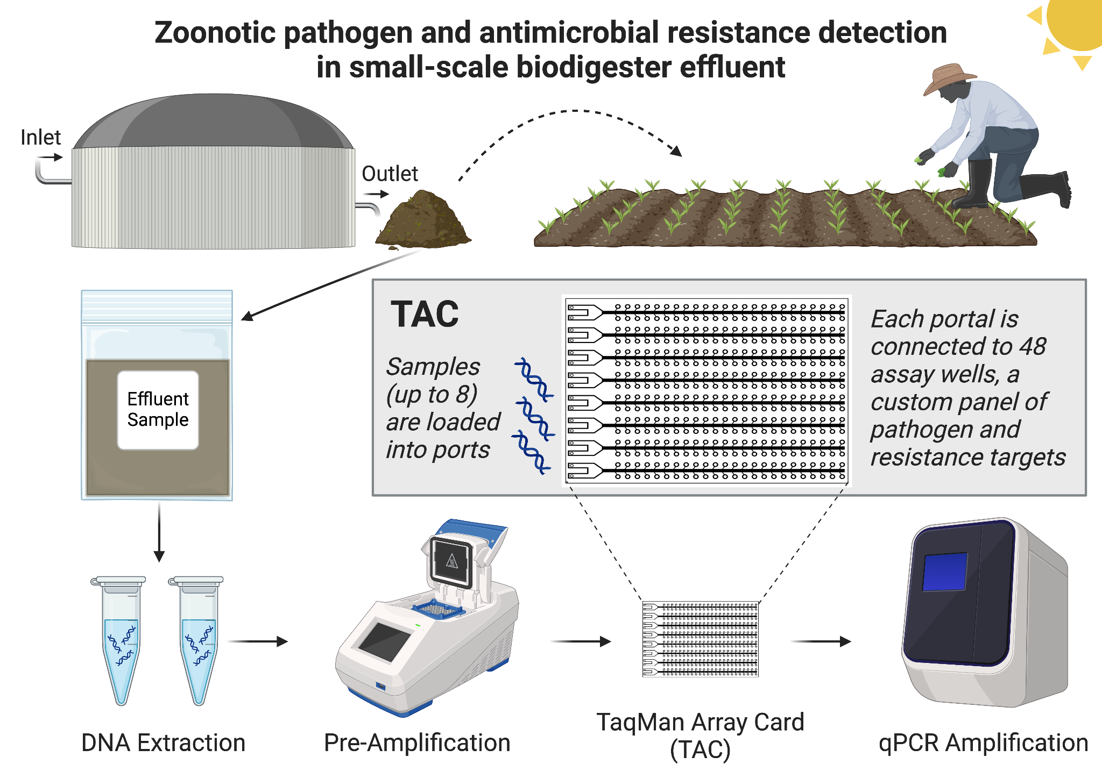
Next steps: TacMan Array Cards (TAC)

Slide 31
Advantages of TAC
High throughput | Simultaneously tests for dozens of pathogens (up to 48 targets across multiple samples – 7 samples + 1 non-template control) in one run.
Multiplexing efficiency | Conserves reagents and time compared to running separate qPCR reactions for each target.
Reproducibility | Standardized format improves consistency across labs and runs.
Sample volume efficiency | Requires minimal nucleic acid input (beneficial when sample material is limited).
Customizability | Cards can be customized with specific pathogen panels (e.g., enteric pathogens, ARGs, fecal indicators).
Semi-automated workflow | Reduces pipetting errors and hands-on time when using compatible instrumentation (e.g., QuantStudio).
Quantitative potential | Can provide quantitative Cq values when used with standard curves.
Wide application | Suitable for clinical, environmental, food, and water surveillance studies.

Slide 32
Limitations of TAC
Cost | Expensive per card (~$300+), especially for large-scale studies.
Equipment needs | Requires specialized qPCR instruments (e.g., QuantStudio 7 or 12K Flex) not always available in LMIC labs.
Batching constraint | Cards are fixed to 6–8 samples + controls; inefficient if you have an odd number of samples.
Limited flexibility post-manufacture | Once printed, targets cannot be changed without redesigning the card.
Throughput trade-off | Compared to open-format 384-well qPCR, TAC has fewer total wells and less flexibility in combinations.
Standard curve challenges | Generating accurate standard curves for all 48 targets can be labor-intensive and may vary by matrix.
Not ideal for exploratory work | Better suited for hypothesis-driven target lists rather than discovery-based approaches like metagenomics.
Sensitivity may vary | Lower sensitivity than singleplex qPCR for some targets due to reaction volume and multiplexing effects.

Slide 33
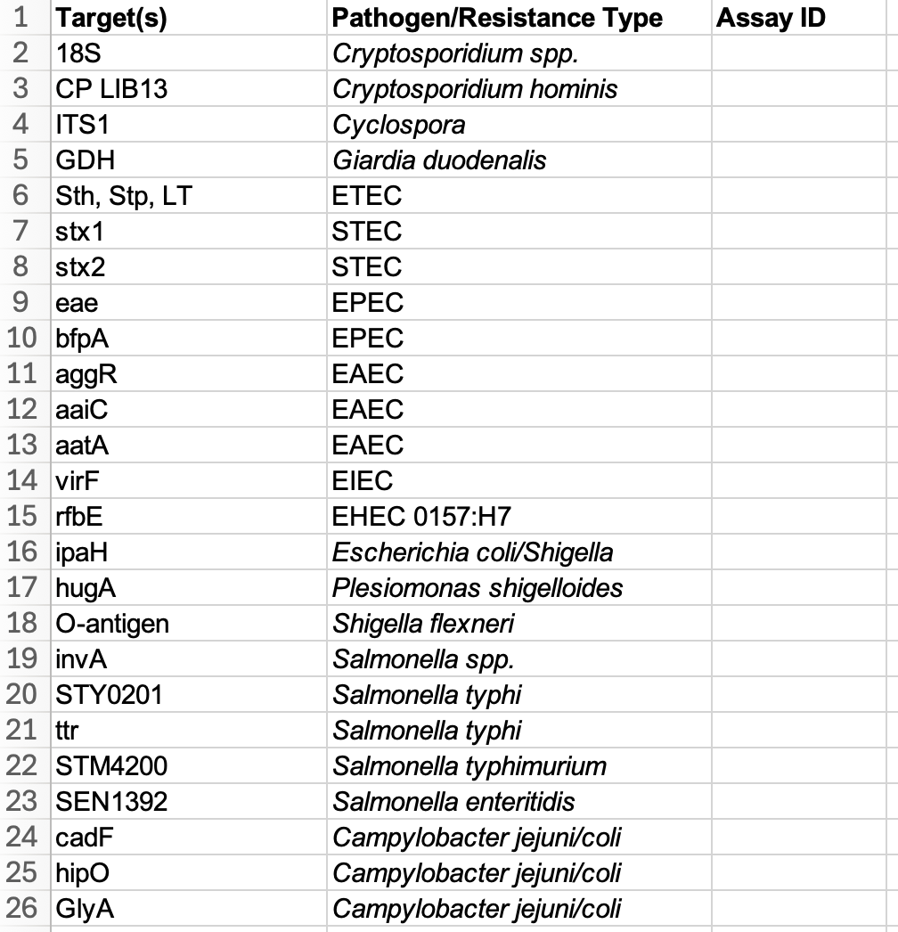
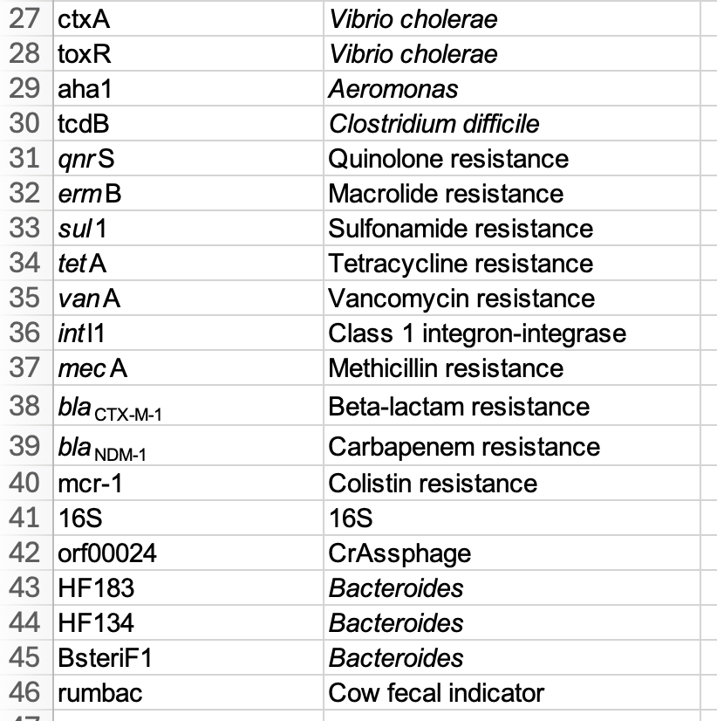
Example TAC Target List

Slide 34
Best Practices for Data Management and Processing

Slide 35
Why Good Data Practices Matter
Goal: Build a clean, secure, and well-documented data pipeline.
High-quality data management ensures:
Accurate analyses
Reproducibility
Transparency in research
Efficient teamwork and troubleshooting
Poor practices can lead to:
Irreversible data loss
Wasted time fixing preventable errors
Misleading conclusions

Slide 36
Best Practices for Data Entry & Storage
Enter data regularly to avoid memory-based errors
Use consistent formats (dates, IDs, units)
Never edit raw data files manually — keep them locked or read-only
Maintain a data log: Use a notebook, spreadsheet, or README to record:
When errors are found
What changes were made
Who made them
Store data in a central, secure location (e.g., Google Drive, Box, OneDrive)
Use R-friendly paths (e.g., via boxr::box_read() or googledrive, googlesheets4)
Avoid local-only files on personal laptops

Slide 37
Clean Your Data with Scripts
Write a data cleaning script (e.g., 01_clean_data.R) that:
Filters out bad rows
Fixes typos, recodes values
Handles missing or duplicate values
Automate fixes instead of editing Excel manually
Version your data (e.g., raw/, processed/, final/)
Use comments in R to document each step

Slide 38
Organize Your Folders for Collaborators
project-folder/
├── data/
│ ├── raw/ # Unedited files
│ └── processed/ # Cleaned data
├── scripts/
│ ├── 01_clean_data.R
│ ├── 02_merge_labdata.R
│ └── 03_analysis.R
├── outputs/ # Figures, tables
├── logs/ # QA log, error notes
└── README.md

Slide 39
Bonus: Working With Cloud Storage in R
See cloud_storage_r.md file under /resources in the training GitHub repository

Slide 40
Setup – Getting started in GitHub

Slide 41
Version Control and Git
Version Control
A system that keeps records of your changes.
Users keep entire code and history on their local machines.
Allows for collaborative development.
Allows you to know who made what changes and when.
Allows you to revert any changes and go back to a previous state.
Git
A tool which allows you to manage and track changes to files over time.
It keeps track of a file’s history – its tracks changes and who made those changes.
Each version of a file is called a commit.

Slide 42
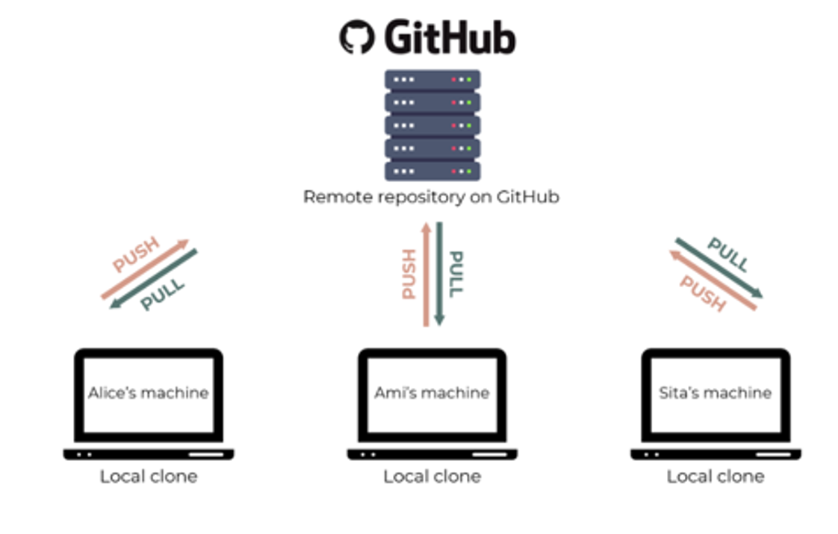
Github Basics:
Repository (A place where work and code is stored)
Branch:
Fork: Makes your own version of a repository
Clone: Makes a copy of a repository
Fetch: Downloads remote repository
Pull: Downloads a remote repository and integrates updates into own code
Commit: Sends changes of a repository to the cloud

Slide 43
Best Practices for Collaborative Coding with Git
Fetch before starting any session
Work in branches
Make a pull request to integrate changes to main branch
Please open setup_instructions.md and begin setting up your workflow.
You can also refer to /resources/github_workshop_workflow.md for more tips!

Slide 44
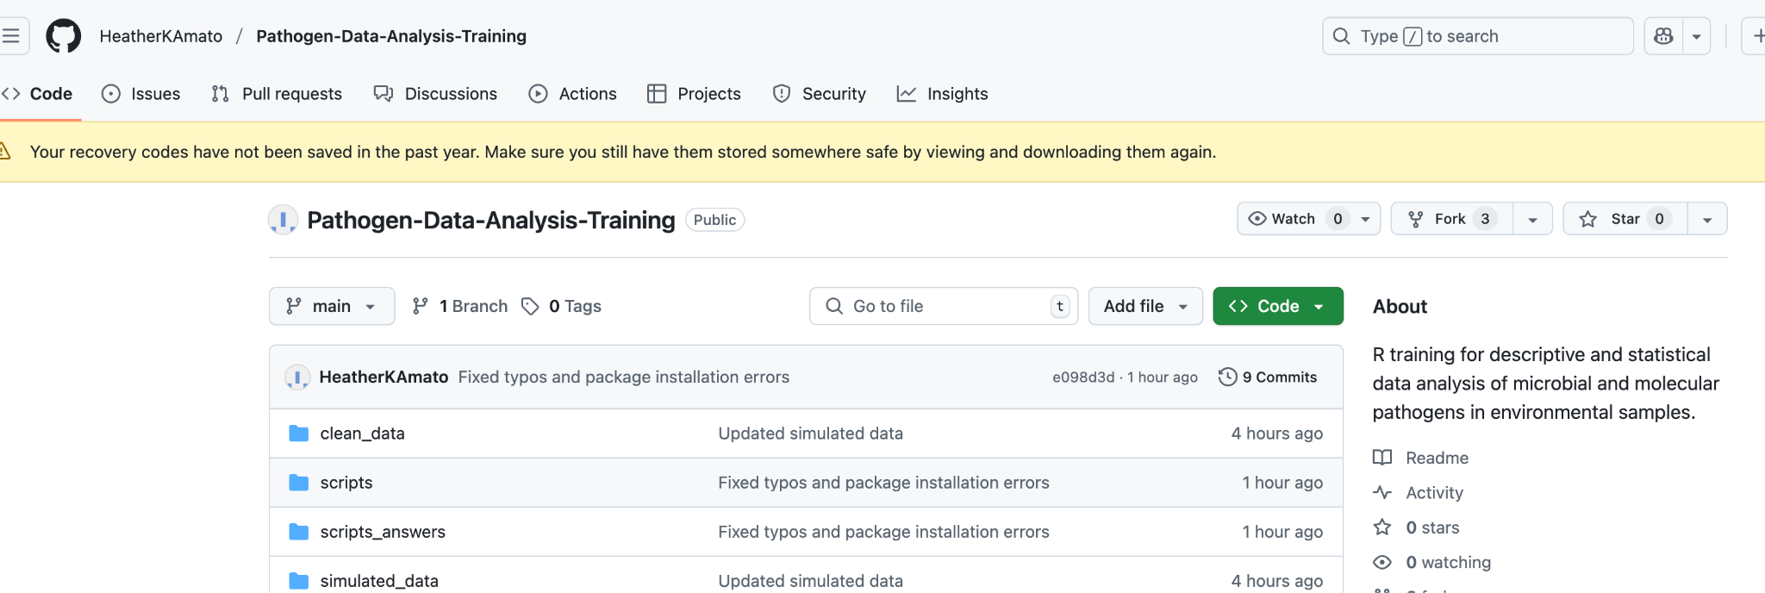
Click on this to fork

Slide 45
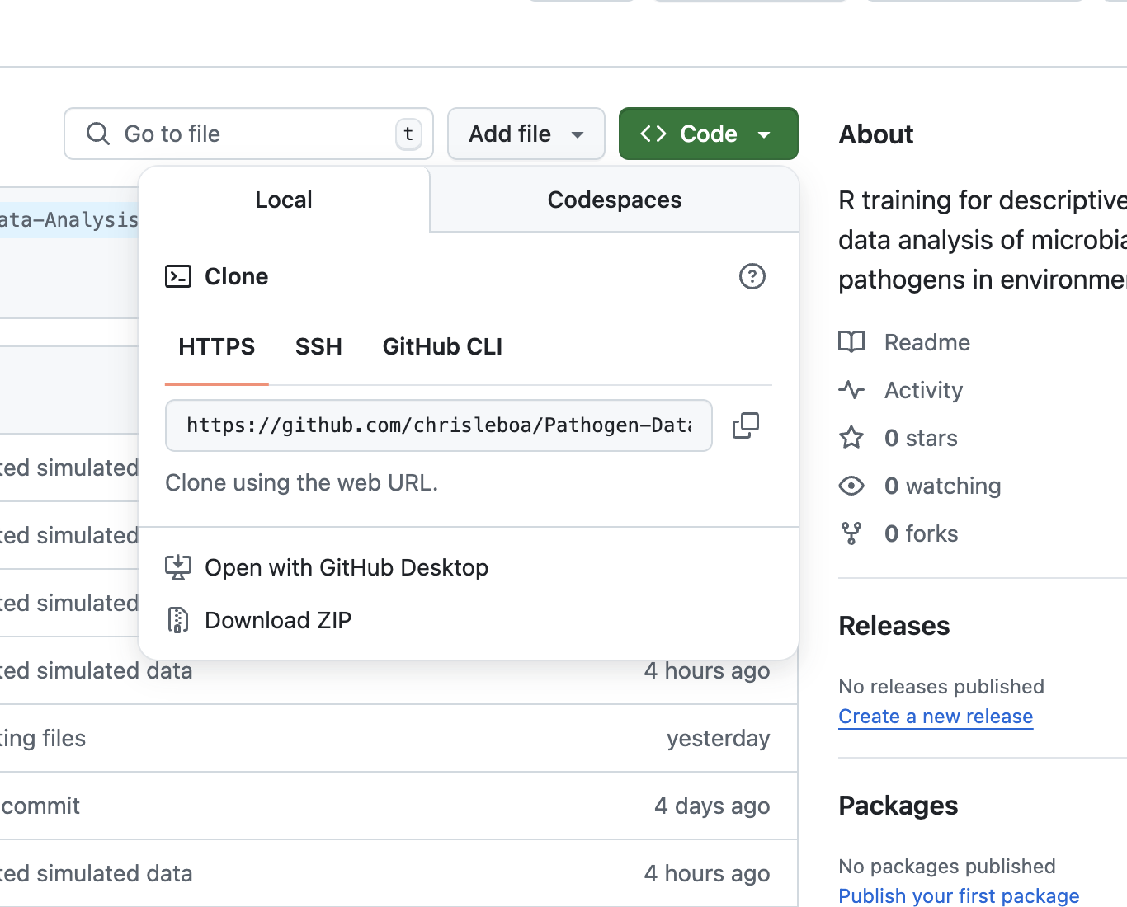
2) Under code copy this URL

Slide 46
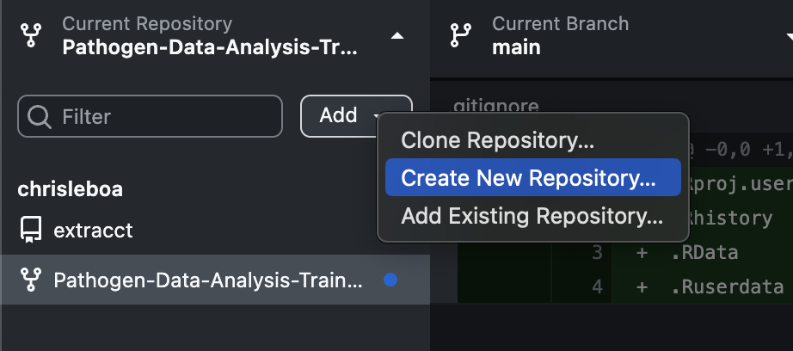

Slide 47
After fork and clone, select “contribute to the parent project”

Slide 48
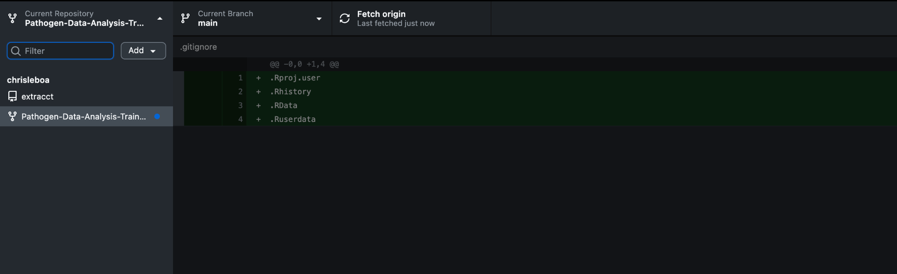
Click this before starting any work session
Commit changes before finishing work session

Slide 49
Let’s Start Coding! Script 1 – Data Processing in R

